Slide 1


CONTACT:
Ashley Harkins – UHC Director
UHC@horsecouncil.org
www.unitedhorsecoalition.org
Notes:
My name is _______________. I work for ___________________, but am here today representing the United Horse Coalition through their Ambassador program. I’d like to share information about the organization and offer examples of how you can help decrease the number of at-risk horses, as well as help those who are in transition.

Slide 2
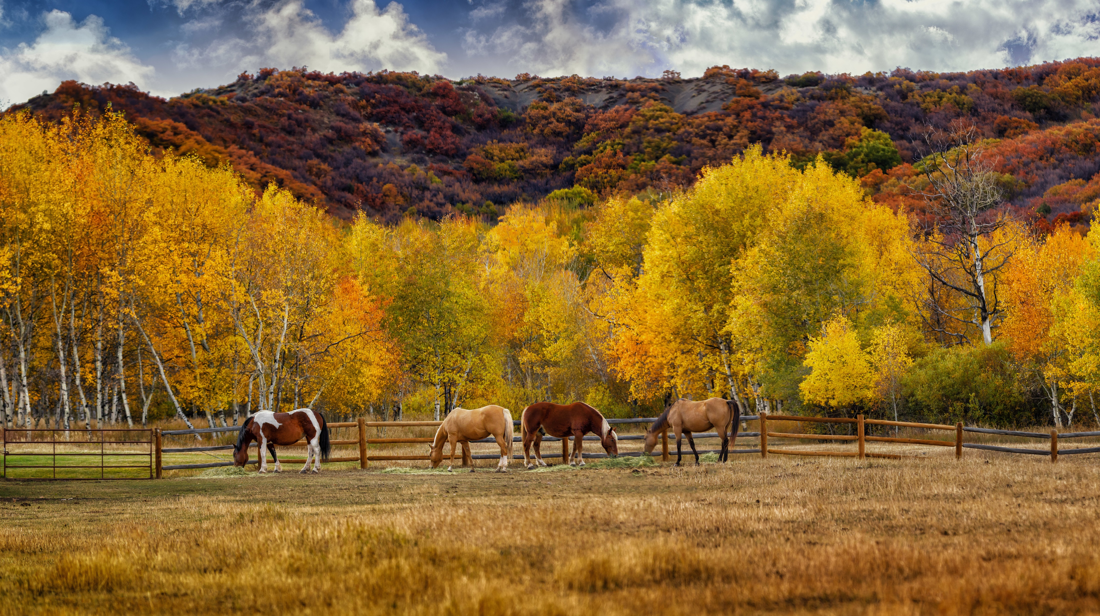
TERMINONLOGY
Changing the way we talk about “unwanted” horses.
  AT-RISK: An equine that has an increased possibility of experiencing a situation of neglect, abuse, or general poor welfare.
  IN TRANSITION: Any equine that is currently in transition from one home, vocation, opportunity or owner to the next.
Notes:
We have had a shift in the way we talk about unwanted horses, we ourselves have had a name change from Unwanted Horse Coalition to United Horse Coalition because the term unwanted carries a negative connotation to it.
When we talk about at-risk horses, formerly unwanted horses, it simply means “An equine that has an increased possibility of experiencing a situation of neglect, abuse, or general poor welfare.”
When we talk about a horse that is in transition, it can be “Any equine that is currently in transition from one home, vocation, opportunity or owner to the next.”

Slide 3
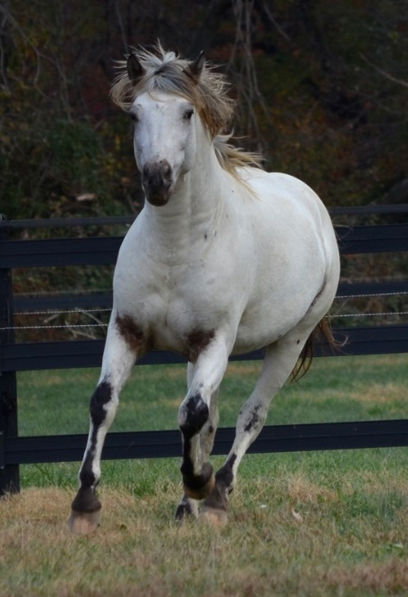
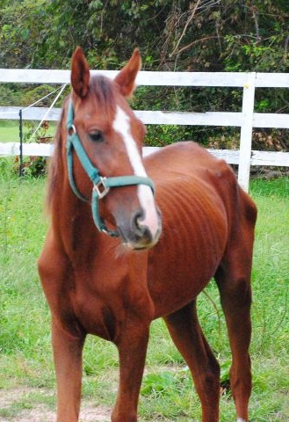
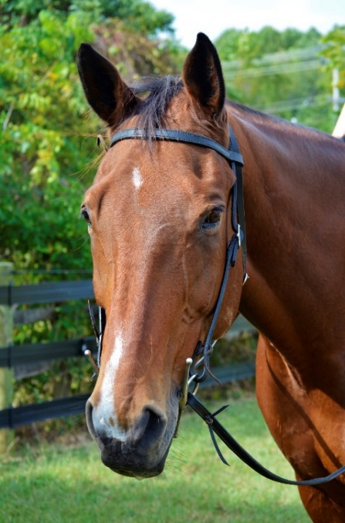
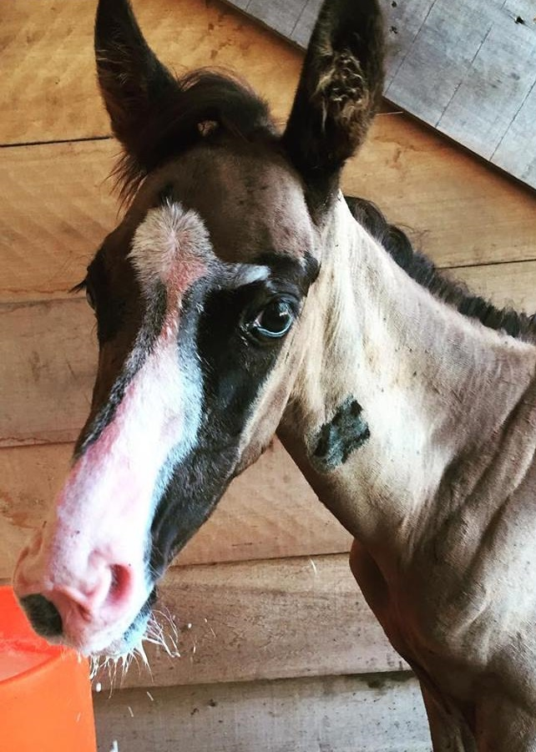
What Does an AT-RISK
Horse Look Like?
Avalanche, 12 yo Appaloosa stallion
Takoda, 5 yo Mustang mare
Jack, 16 yo
Appendix QH gelding
Toby, 2 mos
Orphan foal
Notes:
What does an at-risk horse look like?
Takoda might look like the obvious choice, but all four were at-risk at one point. Luckily, after the work of two rescues in Maryland, they are now in loving homes.

Slide 4

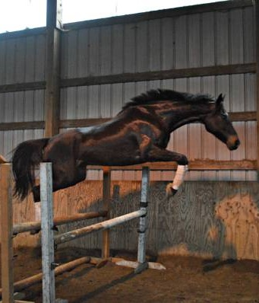

What Does an AT-RISK
Horse Look Like?
Old
Incurably Lame
Medical Issues
Behavioral Problems
Unattractive or wrong color
Not athletic enough
Is Dangerous to themselves or others
Fails to meet owner’s expectations
Costs too much to keep
Normal, healthy horses too!
Two Socks, 7yo OTTB
Notes:
So, what does an at-risk horse look like? The truth is, an at-risk horse can be any of these.
An at-risk horse can look old, lame, unattractive. Maybe he’s dangerous, or not an easy keeper and too expensive to feed. Maybe that equine has medical issues, or maybe he has outlived the purpose for which the owner originally intended for the horse. More often than not however, an at-risk horse can look perfectly normal and healthy and have no issues at all.

Slide 5
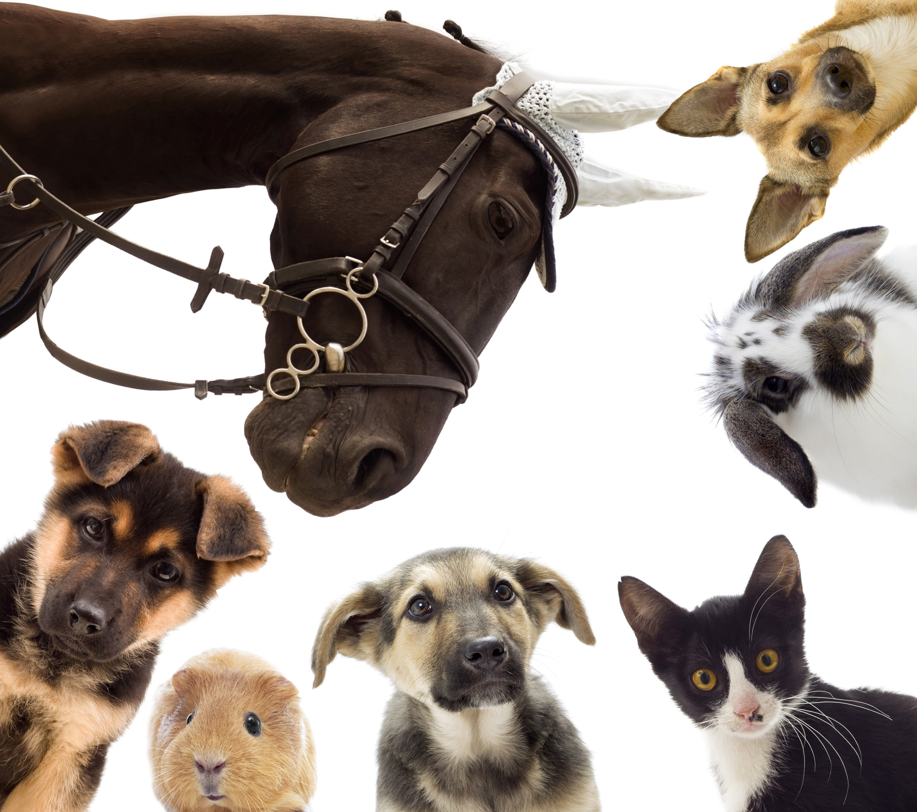
UHC History:
United Horse Coalition came about through the Unwanted Horse Summit in 2005
Key stakeholders came together to start a dialogue on the issue.
Purpose was to develop consensus on the most effective ways to address the issue of horses at-risk or in transition.
In June 2006 the UHC was folded into the American Horse Council
Notes:
Originally formed in 2005 when the American Association of Equine Practitioners held a summit during AHC’s Annual Conference with other Equine Industry partners and stakeholders, with the intention of starting an open dialogue on the issues surrounding at-risk horses in America during the time.
Our original purpose was to develop consensus on the most effective way to work together as an industry to address the issues surrounding horses who were at-risk or in transition, and in June of 2006, the UHC was folded into the American Horse Council where we now operate.

Slide 6

WHO IS THE UHC?
A broad alliance of diverse equine organizations within the Horse Industry.
Inclusive member base = wide range of knowledge and experience, excellent opportunity for collaboration to drive positive change within the equine industry.
Provide information and important resources for:
  Current horse owners
  Prospective horse owners
  Breeders
  Sellers
  And other horse organizations
Notes:
The United Horse Coalition is a broad alliance of equine organizations that have joined together to educate the horse industry about the issues facing horses at-risk or in transition.
UHC itself is comprised of a coalition of equine organizations which include Industry organizations, breed organizations, horse councils, as well as equine rescues and sanctuaries.
We are an inclusive coalition which means we have a wide range of knowledge and experience within our member base
UHC operates on a consensus bases, which means that our decisions and actions represent the collective wisdom of all our members.

Slide 7
UHC MEMBERS: our diversity is our strength
Members:
Levels of Membership:
Industry Partners
Rescues
Sanctuaries
State Horse Councils
Associations
Equine Businesses
Foundations
And more!
Full Membership
Associate Membership
Supporting Membership
Non-Profit Membership
Notes:
Member Organizations: Industry partners, Rescues, Sanctuaries, Horse Councils, Associations, Equine Businesses, Foundations, and more!
Levels of Membership: Full, Associate, Supporting, and Non-Profit.

Slide 8
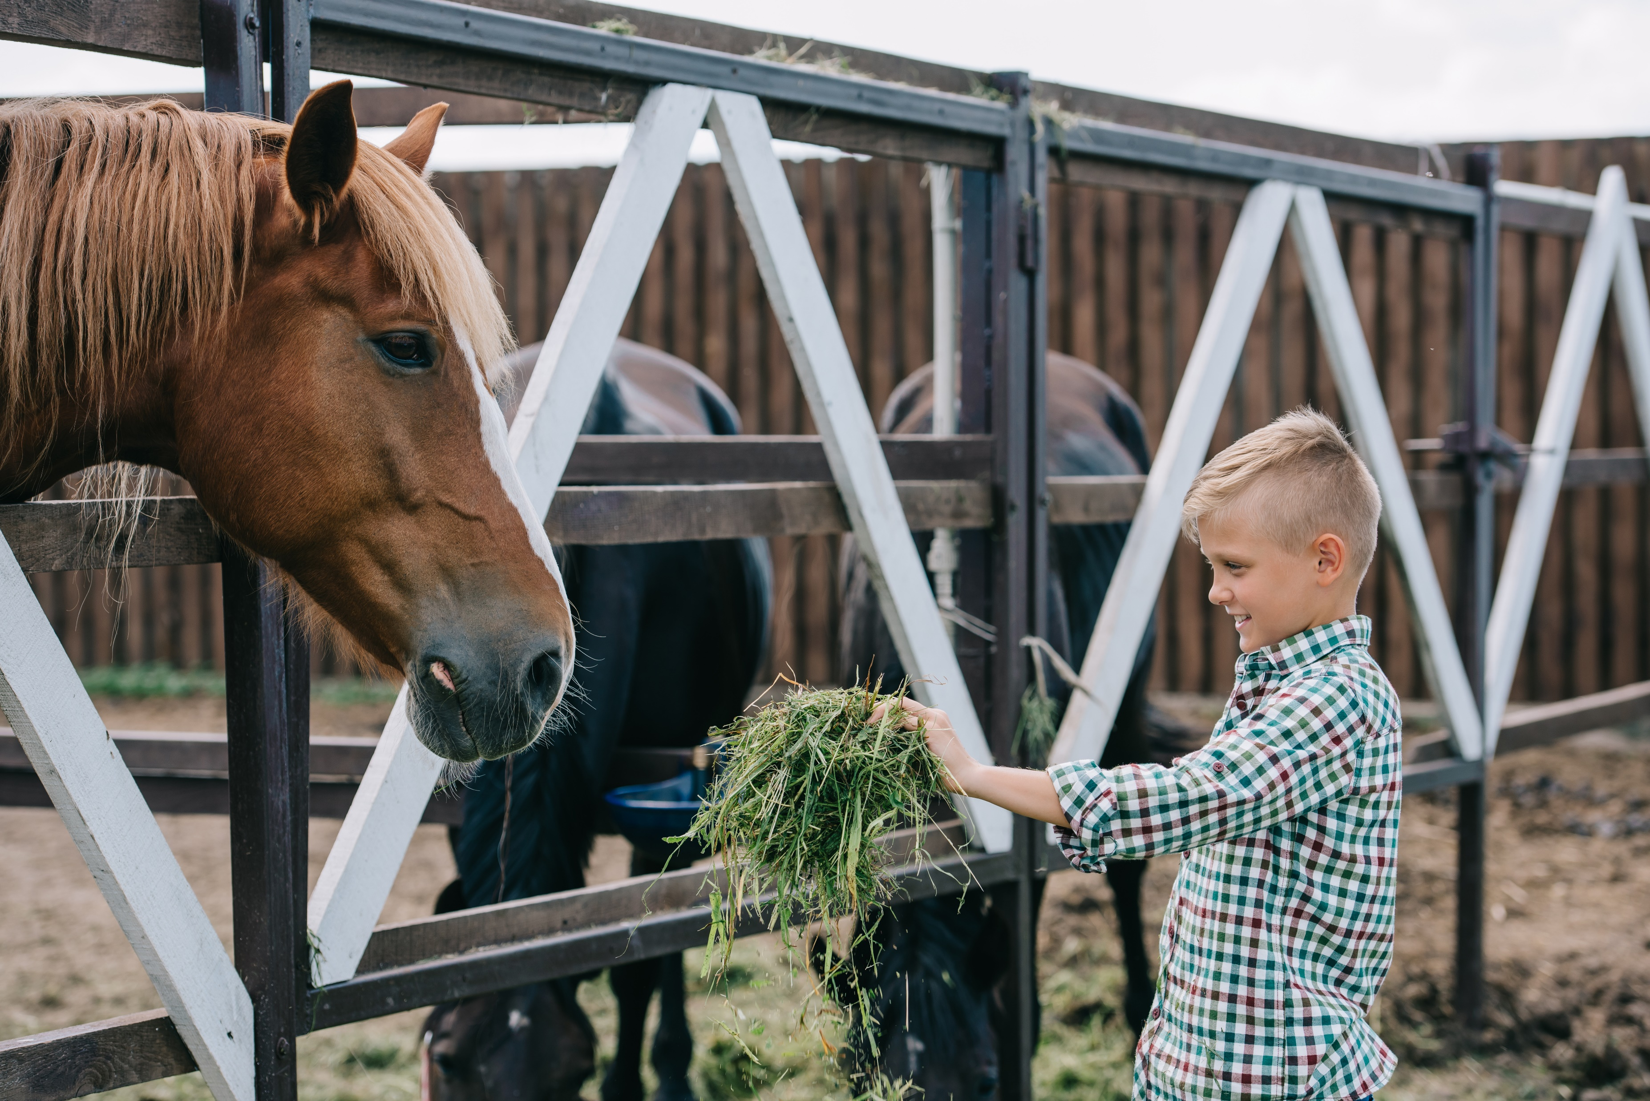
The UHC currently consists of 241 member organizations
6 Full Members
4 Associate Members
6 Supportive Members
225 Non-Profit Members
Notes:
In 2018 we added a non-profit membership level to our member base which is open to any registered 501c3 in good standing.
Currently our membership base consists of:
6 Full Members
4 Associate Members
6 Supportive Members
225 Non-Profit Members

Slide 9




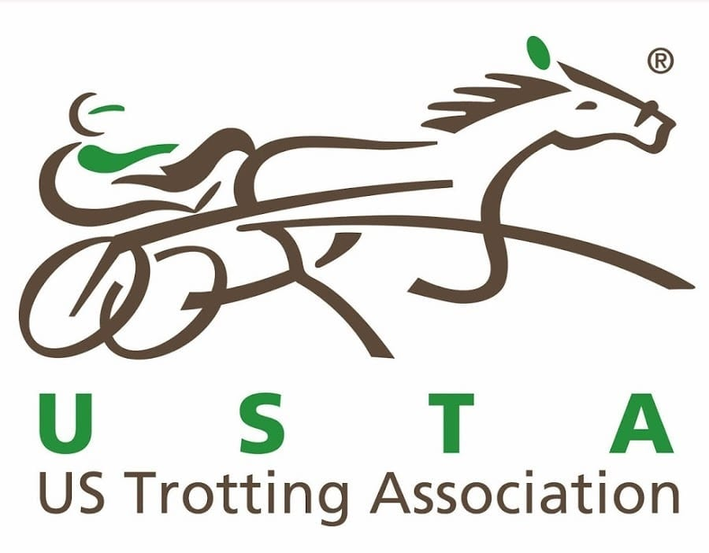

FULL Members
Notes:
Full Members:
American Association of Equine Practitioners
American Quarter Horse Association
American Veterinary Medical Association
The Jockey Club
National Thoroughbred Racing Association
United States Trotting Association

Slide 10
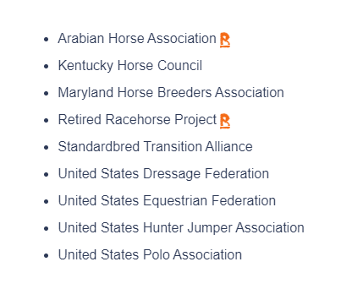
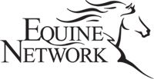



Associate and Supportive Members
Associate Members
Supportive Members
Notes:
Associate Members:
ASPCA
The Equine Network/Active Interest Media
National Horsemans Benevolent & Protective Association
Minnesota Horse Council
Supportive Members:
Arabian Horse Association
Kentucky Horse Council
Maryland Horse Breeders Association
Retired Racehorse Project
Standardbred Transition Alliance
United States Dressage Federation
United States Equestrian Federation
United States Hunter Jumper Association
United States Polo Association

Slide 11
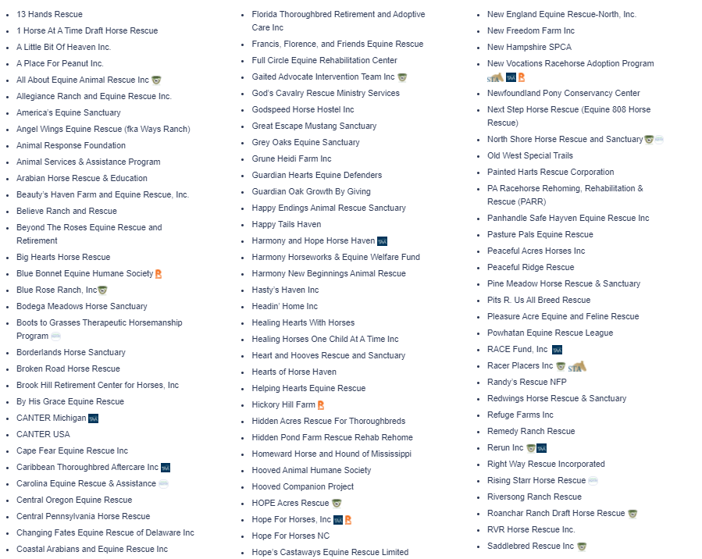
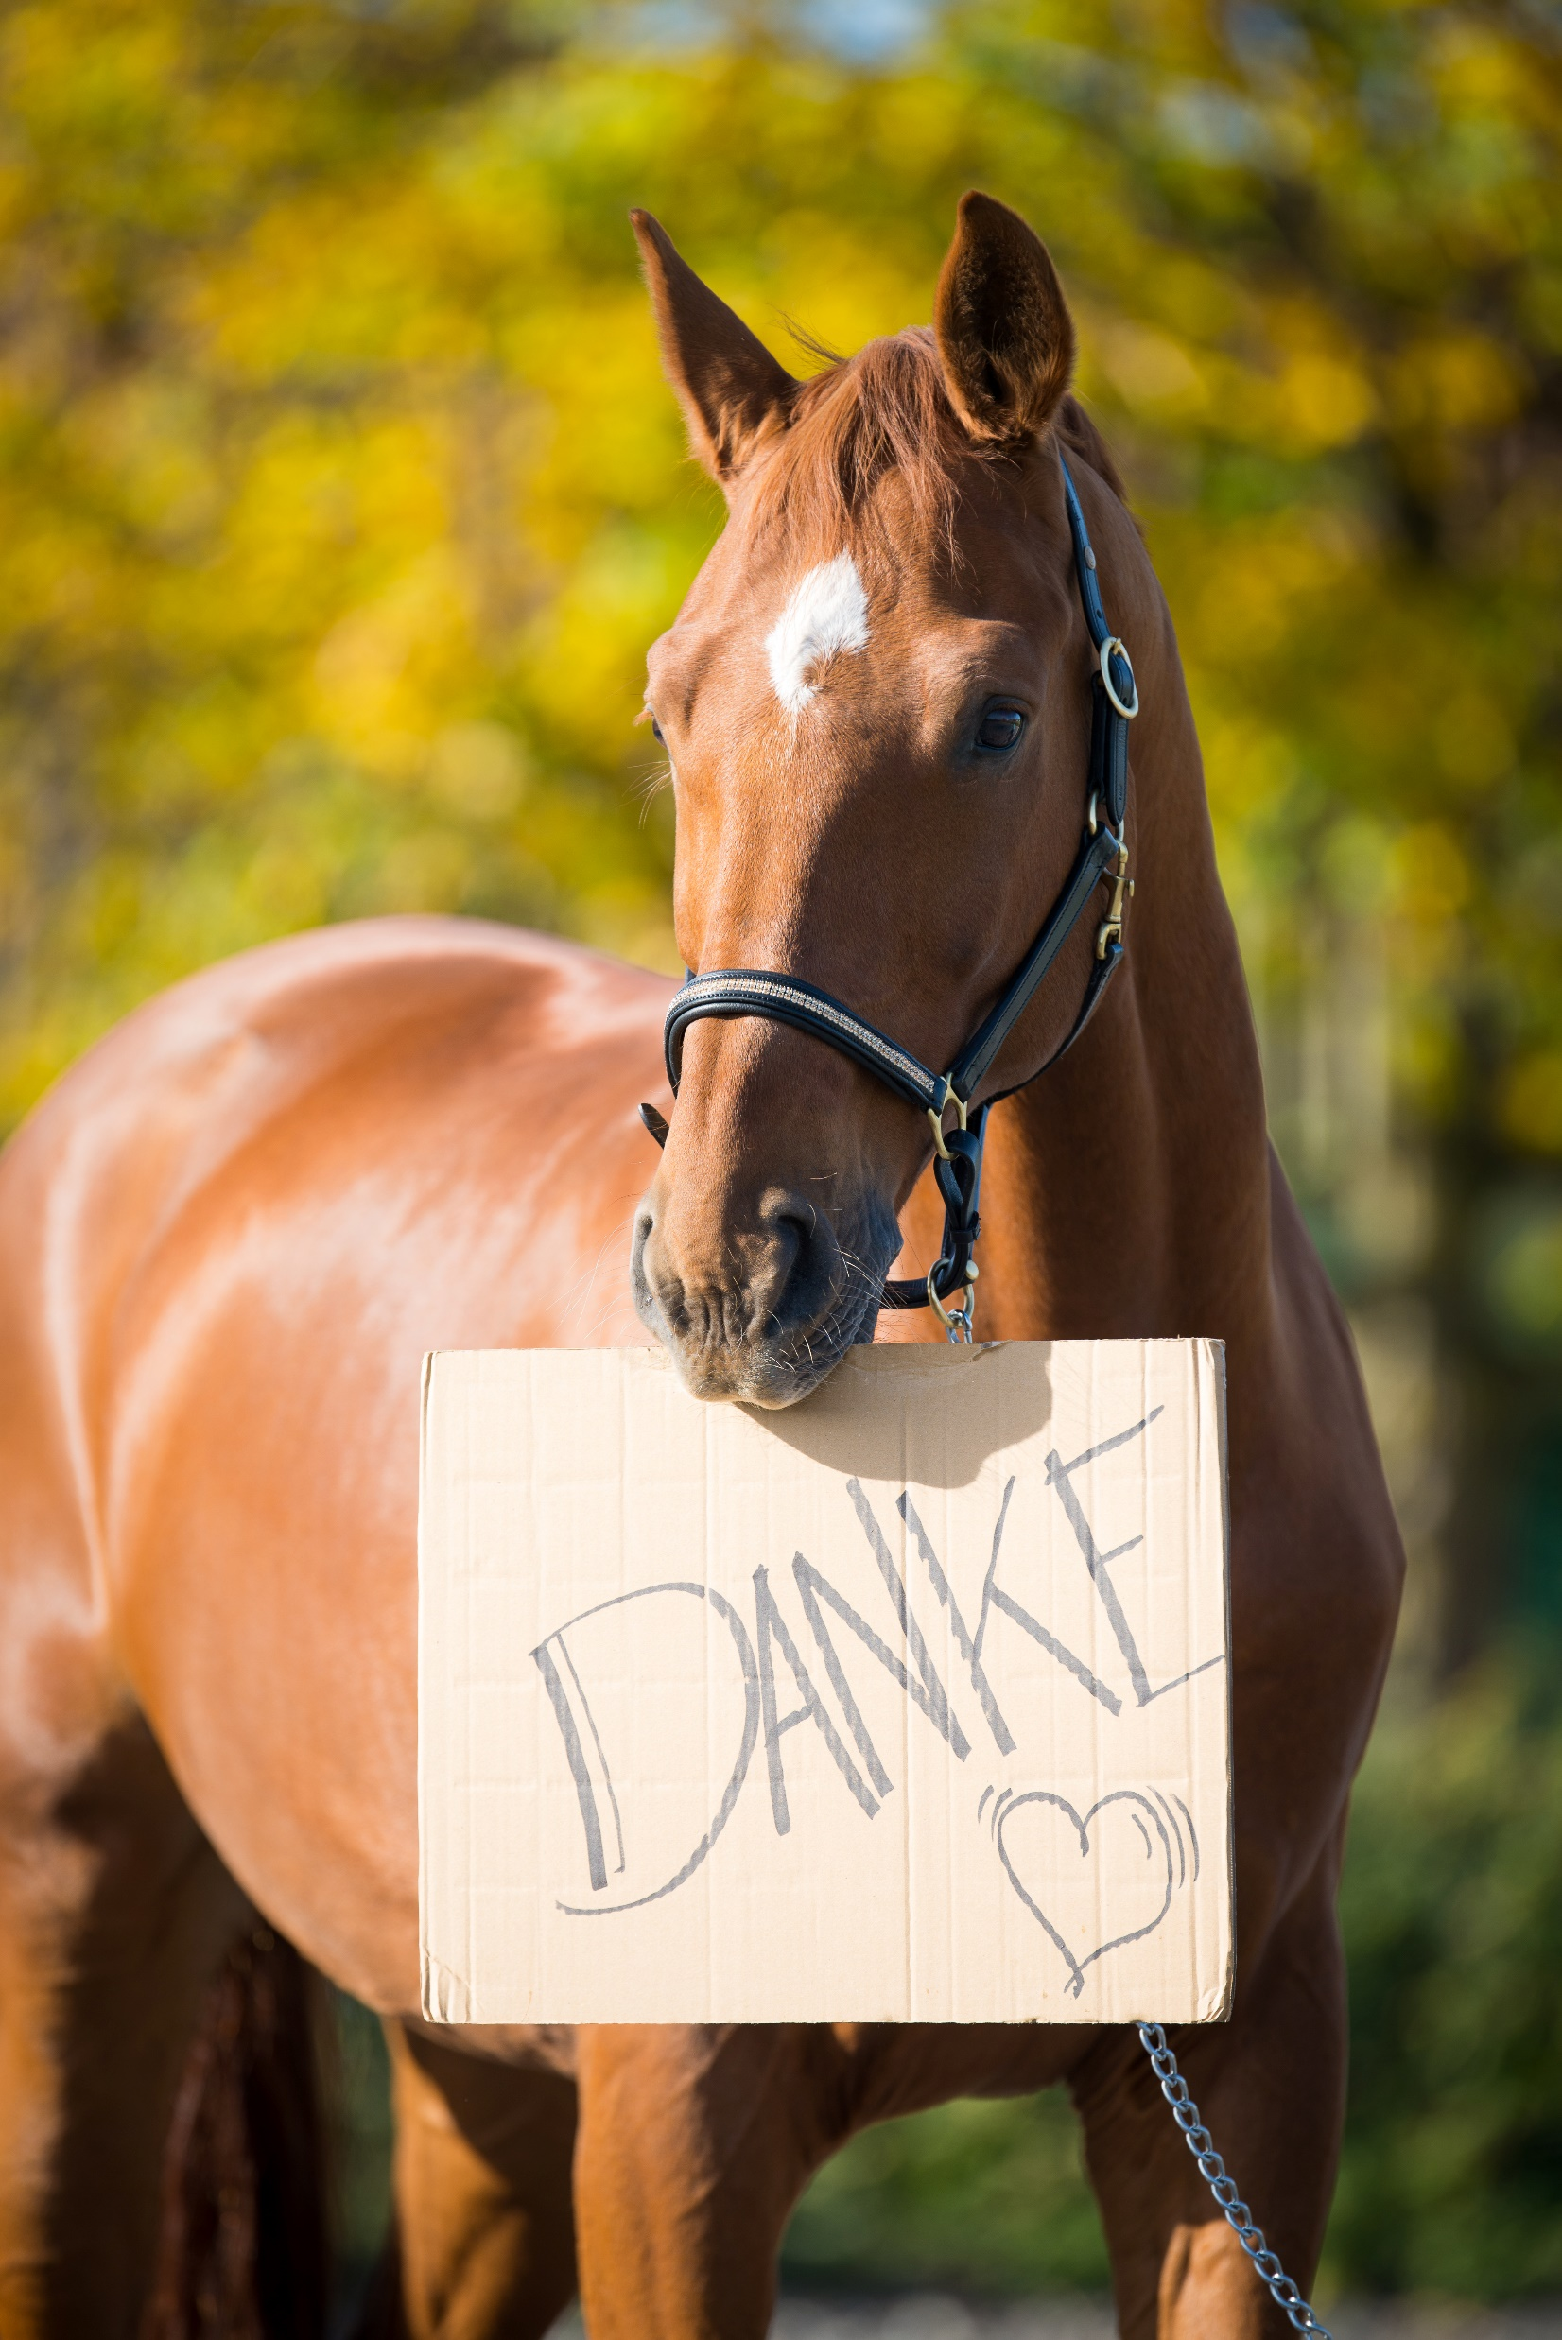
NON-PROFIT Members
Notes:
Thank you to our Non-profit Members for their support of our collective mission of helping at-risk horses and those in transition!

Slide 12
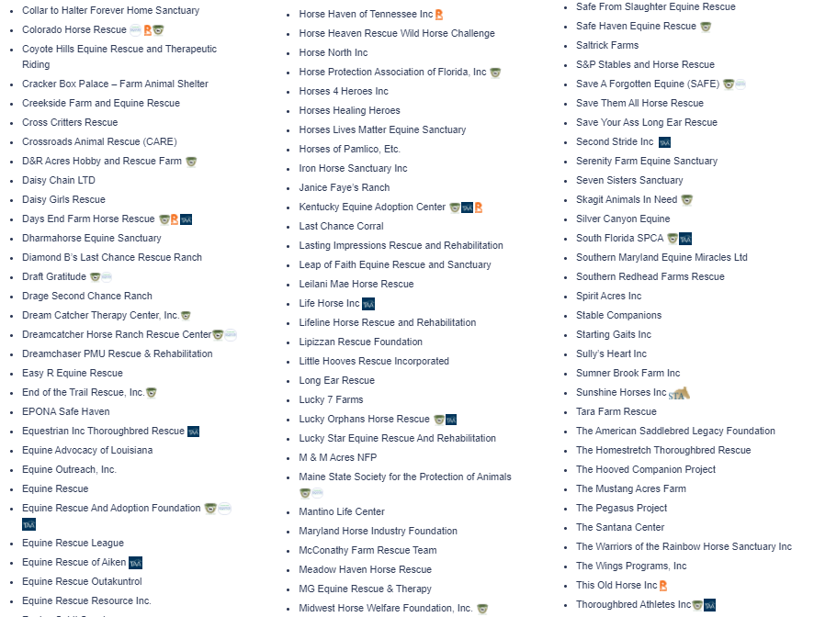
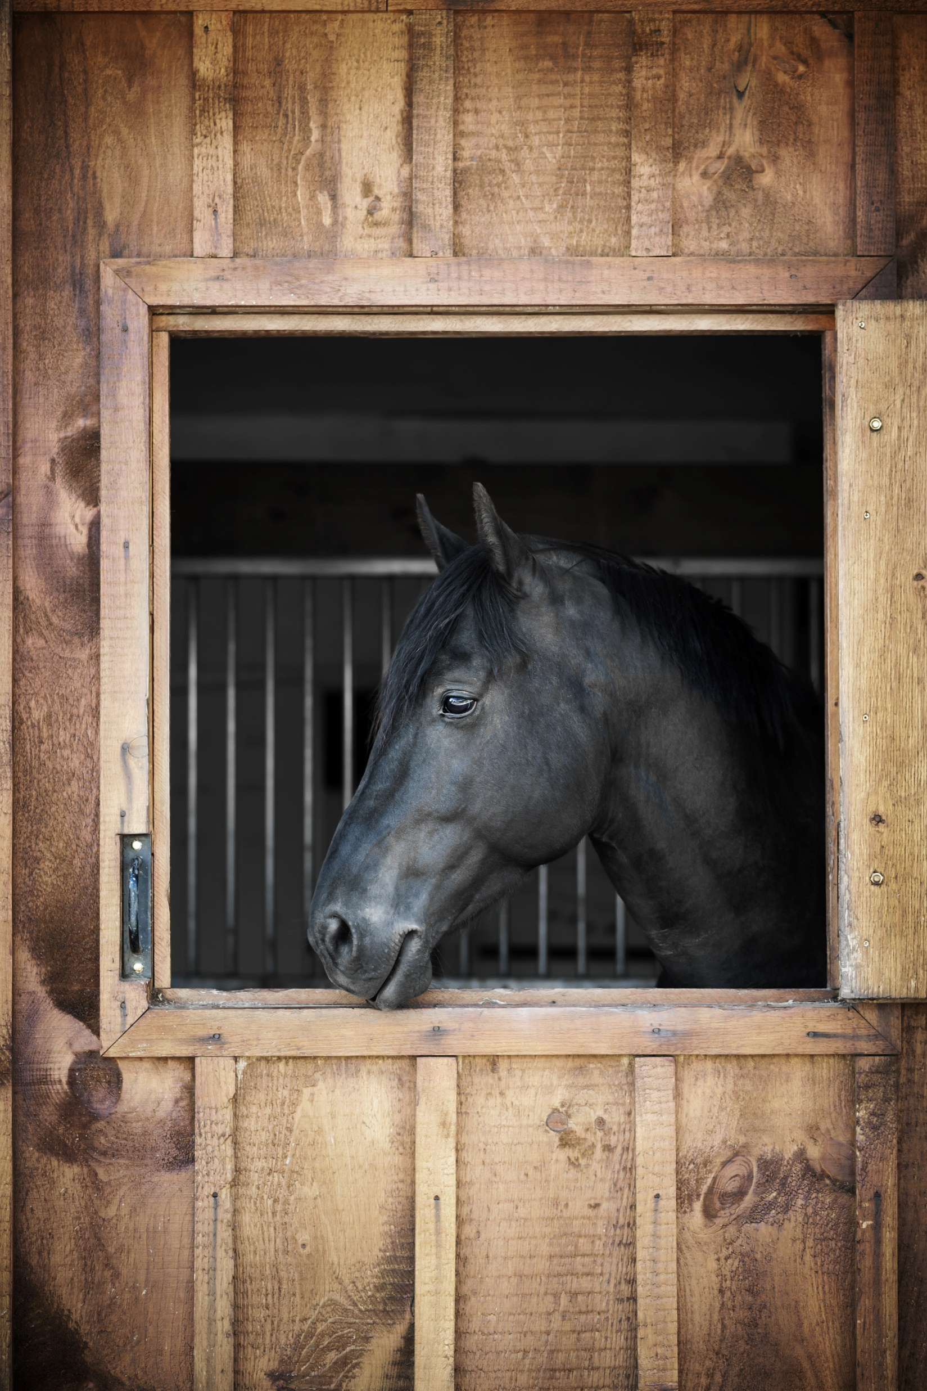
NON-PROFIT Members
Notes:
Non Profit Members Continued

Slide 13
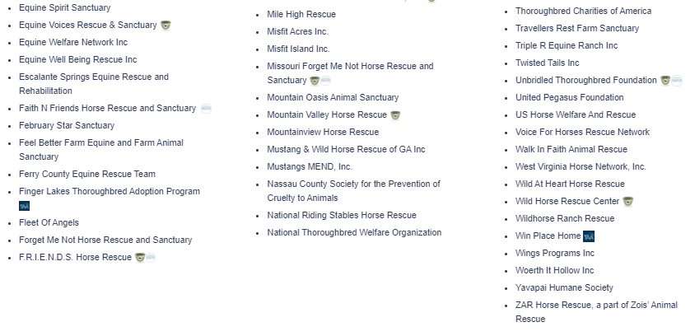
NON-PROFIT Members
Notes:
Non Profit Members continued.

Slide 14
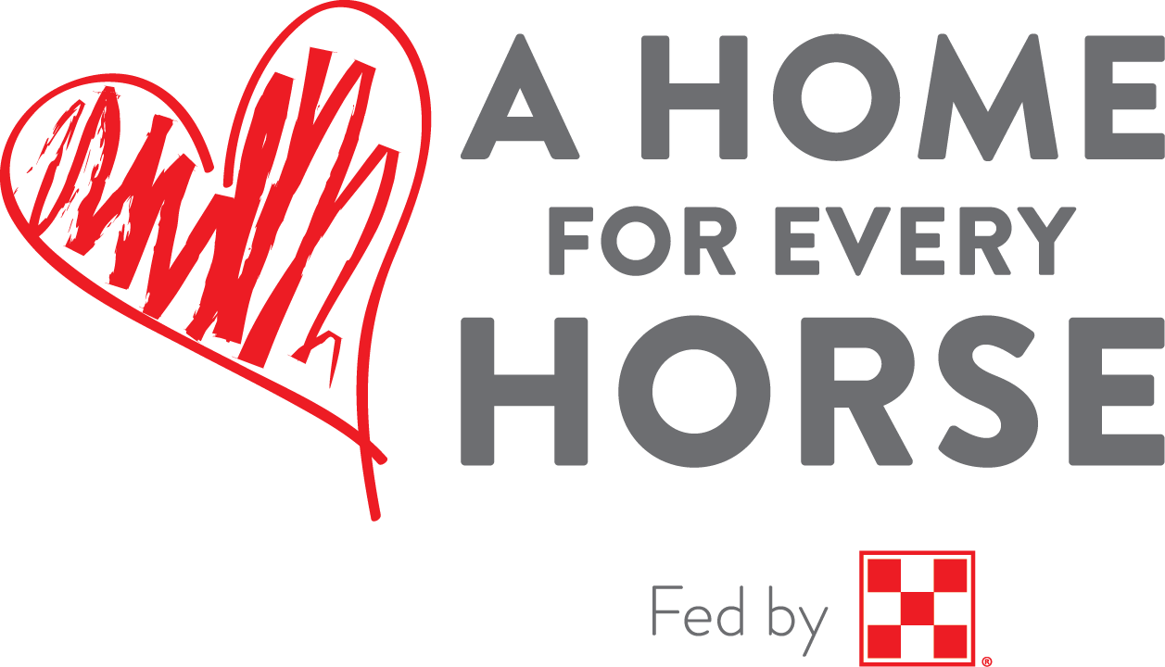
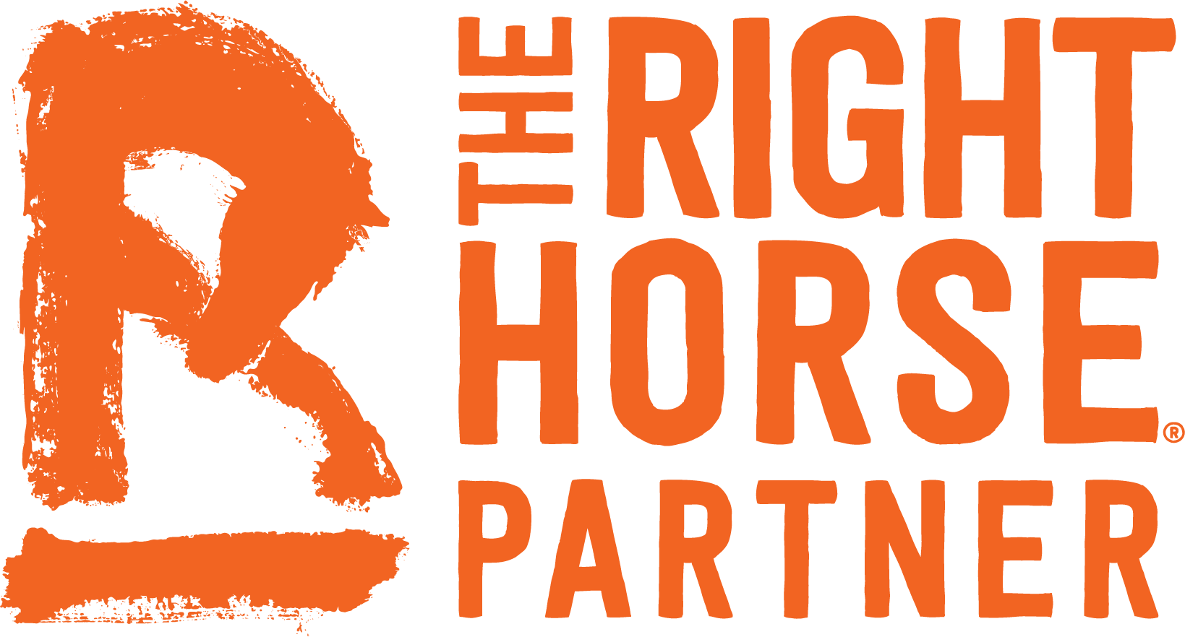
Partnerships/Collaborations
A Home for Every Horse
The Right Horse Initiative
Notes:
A Home For Every Horse:
A Home for Every Horse, created in 2011, is the result of a partnership between the Equine Network, the nation’s leading publisher of equine-related content, and the UHC. The AHFEH program helps connect rescue horses in need of homes with people looking for horses. Registered 501(c)(3) rescue organizations can list their horses for free on Equine.com, the world’s largest horse marketplace, where they can be seen by 300,000 visitors each month.
The Right Horse Initiative:
As a participant in The Right Horse Initiative, the UHC is proud to support a national movement reframing the conversation about equine adoption. The Right Horse Initiative is a collective of industry professionals and equine welfare advocates working together to improve the lives of horses in transition through a dialogue of kindness and respect.

Slide 15
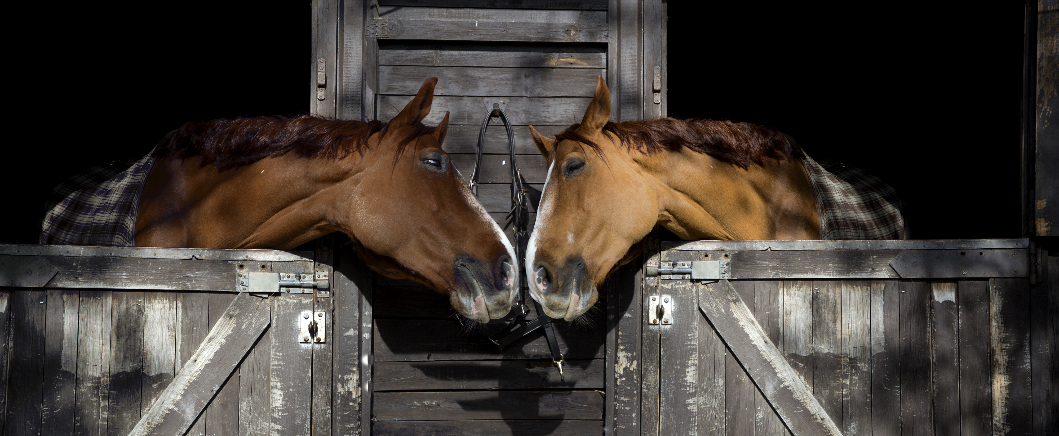
Goals of the United Horse Coalition:
THE UHC IS COMMITTED TO HELPING HORSES AT-RISK, OR IN TRANSITION BY:
Educating current and future horse owners on Responsible Ownership, proper care and breeding, and options available before a horse reaches a state of being at-risk.
Raising awareness about the issue of horses at-risk, and its impact on the horse industry.
Reducing the number of horses at-risk and working toward eliminating the problem.
Ensuring that horses are treated humanely and with dignity
Notes:
The United Horse Coalition is committed to helping horses at-risk, or in transition by:
Educating current and future horse owners on responsible ownership, proper care and breeding, and options available before a horse reaches a state of being at-risk.
Raising awareness about the issue or horses at-risk, and its impact on the horse industry
Reducing the number of horses at-risk, and working toward eliminating the problem
Ensuring that horses are treated humanely and with dignity

Slide 16
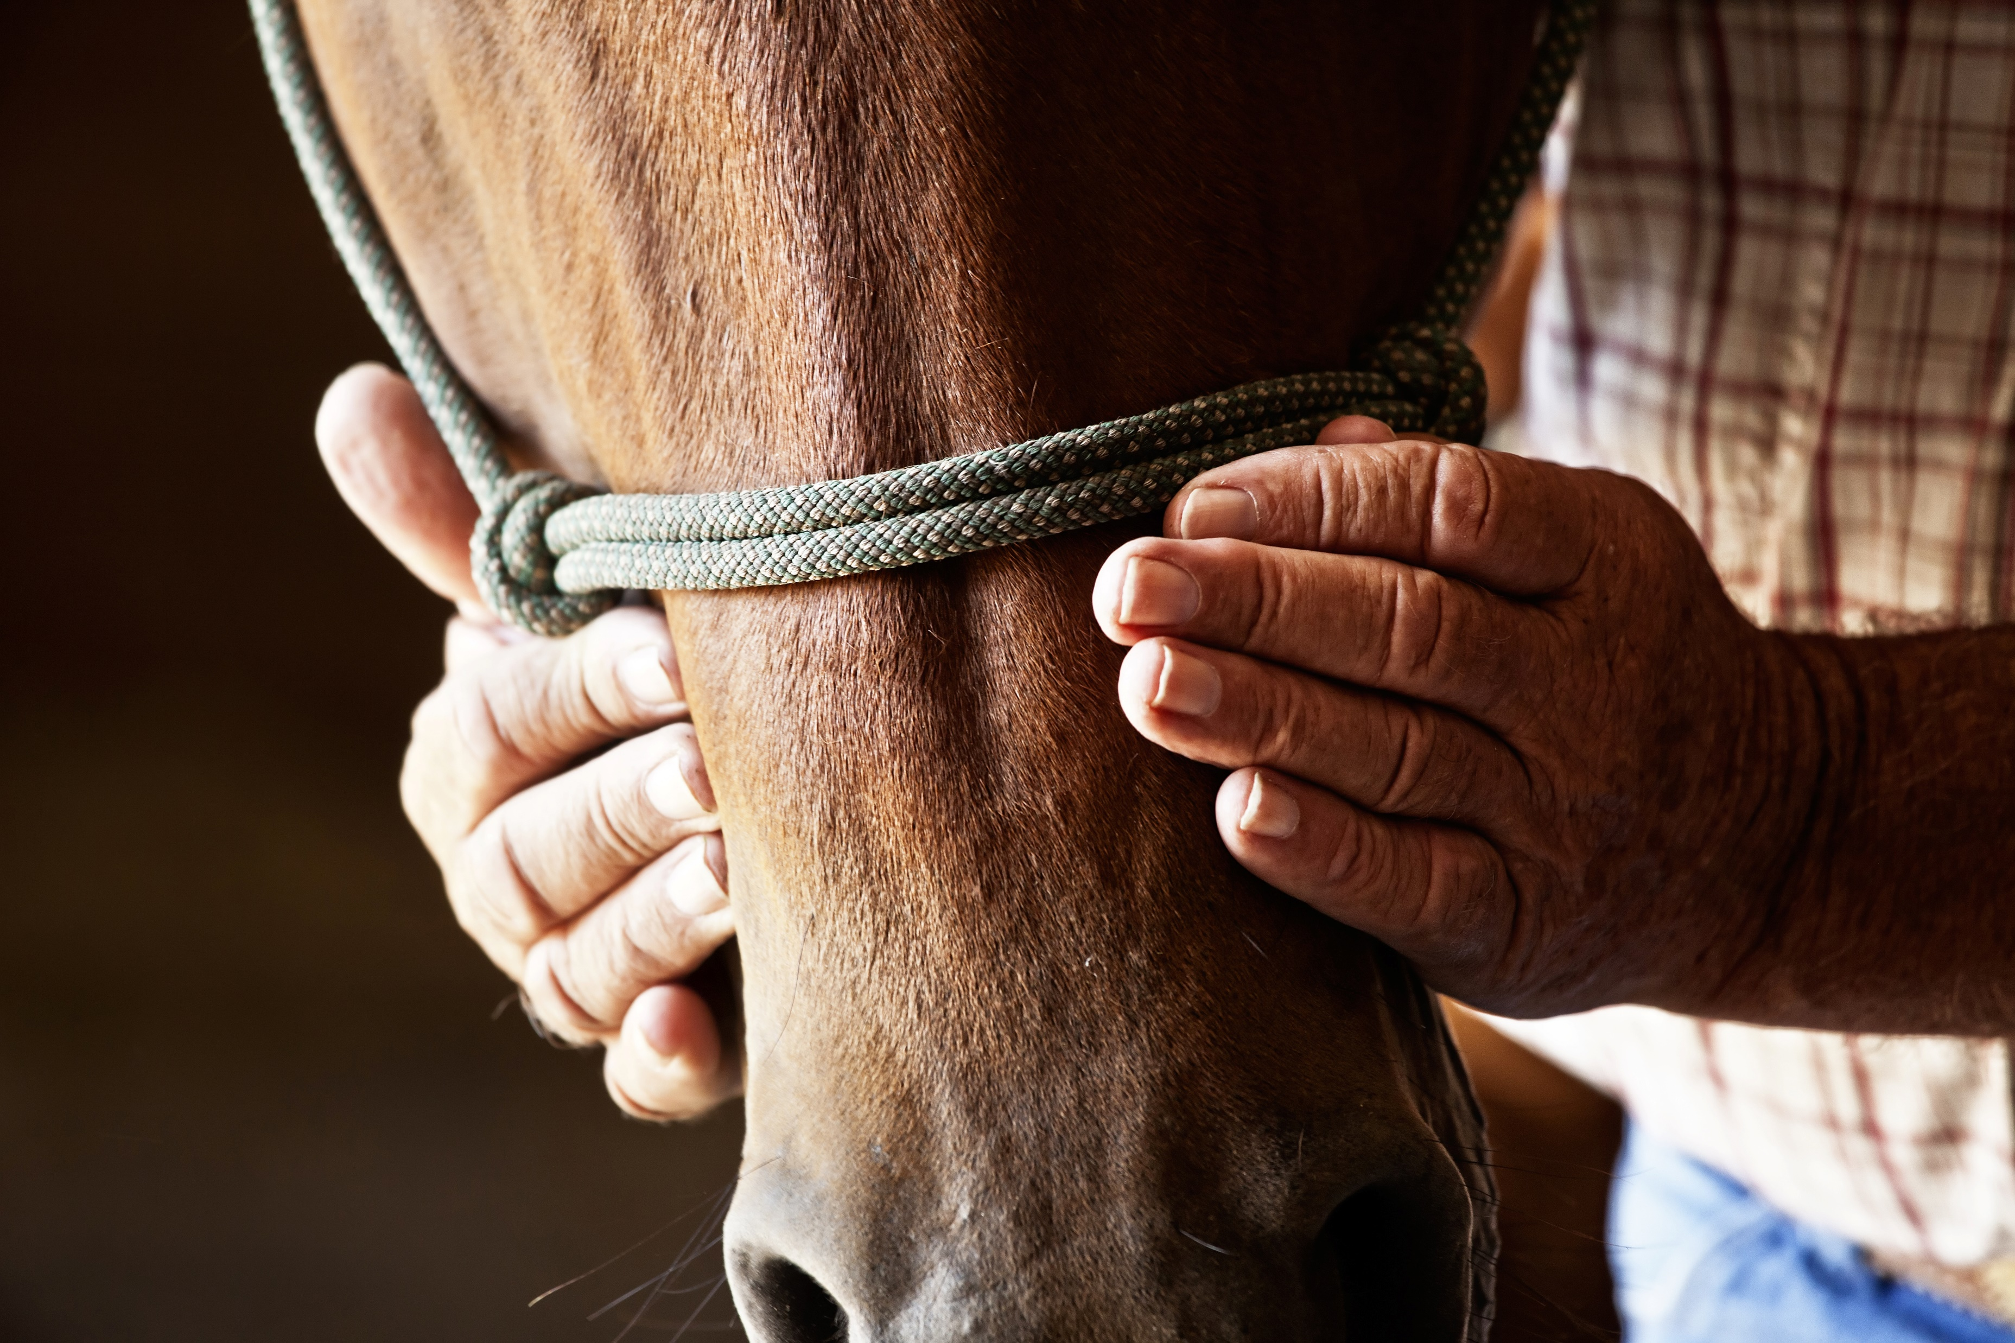
Goals of the United Horse Coalition:
THE UHC IS COMMITTED TO HELPING HORSES AT-RISK, OR IN TRANSITION BY:
Facilitating the exchange of information on adoption, care, and alternative careers
Providing information on end-of-life decisions, including veterinary decisions, euthanasia, and disposal.
Explaining the issue through presentations at industry gatherings, including horse association meetings, conferences, symposiums, and horse fairs.
Notes:
Facilitating the exchange of information on adoption, care, and alternative careers
Providing information on end-of-life decisions, including veterinary decisions, euthanasia, and disposal
Explaining the issue through presentations at industry gatherings, including horse association meetings, conferences, symposiums, and horse fairs

Slide 17
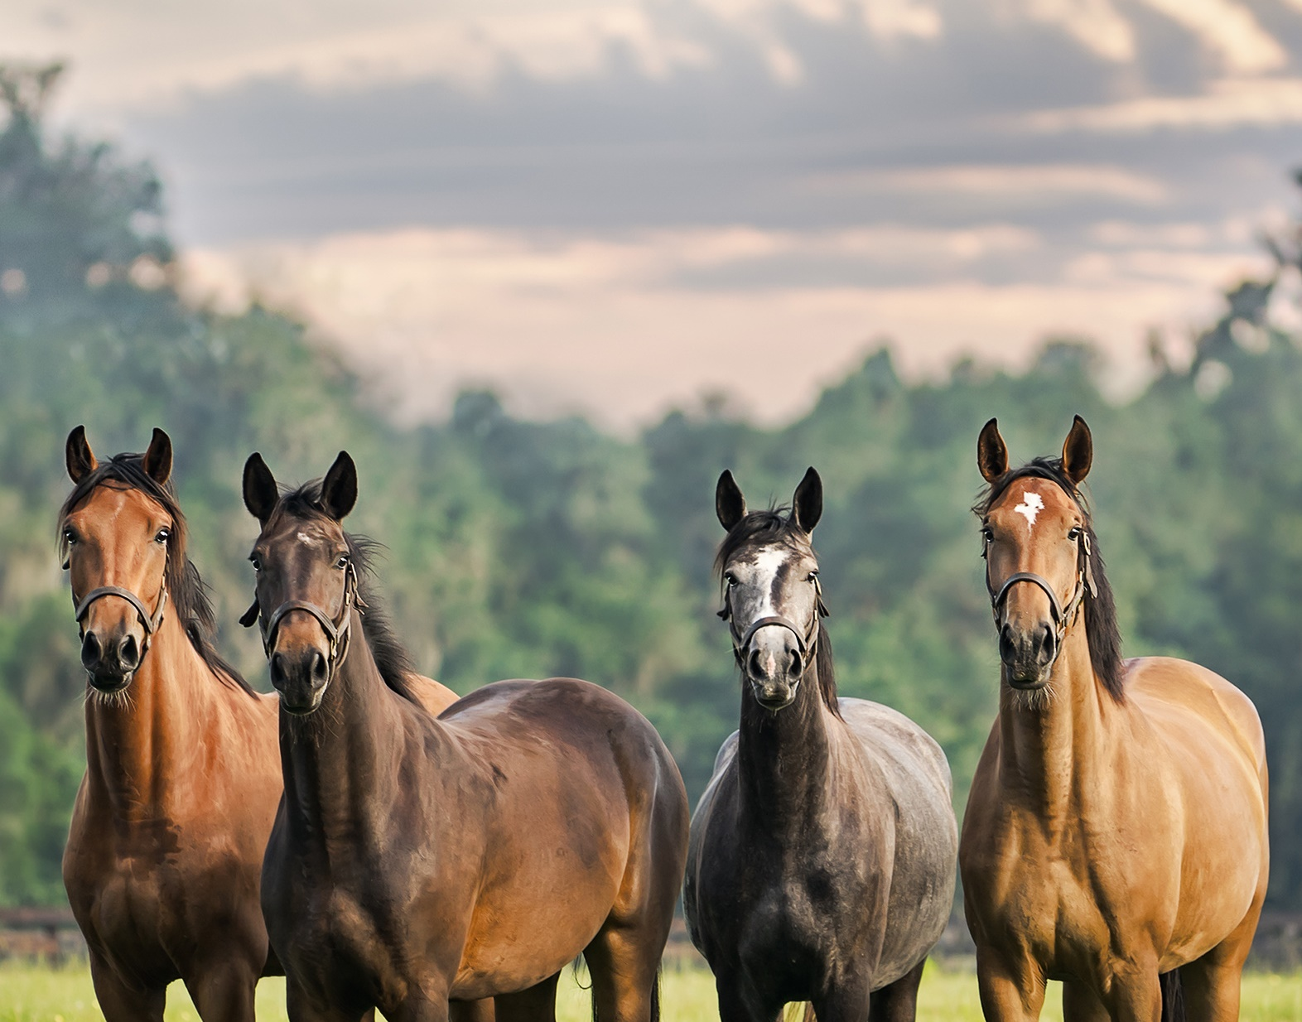
WHAT DO WE DO?
Through industry collaboration, the UHC promotes education and options for at-risk and transitioning horses.
Educated. Advocate. Collaborate.
Educational Materials on Responsible Horse Ownership.
UHC Resource Database
The Equine Welfare Data Collective
Notes:
Our mission statement states that: Through industry collaboration, the UHC promotes education and options for at-risk and transitioning horses.
And we do this by, educating current and future horse owners on responsible ownership, proper care and breeding, and options that are available to owners should they no longer be able to care for their horse, or need to re-home their horse before a horse reaches a state of being at-risk. We are raising awareness about the issues surrounding horses that are at-risk, and the impact it has on the horse industry, and hopefully reducing the number of horses at-risk, so that eventually in a perfect world, we can eliminate the issues surrounding them altogether.
We do this work mainly through education, collaboration, and advocating for at-risk horses throughout all facets of the Equine Industry. This includes promoting our educational materials on being a responsible horse owner, our UHC Equine Resource database, and the Equine Welfare Data Collective which is a program of the United Horse Coalition.

Slide 18
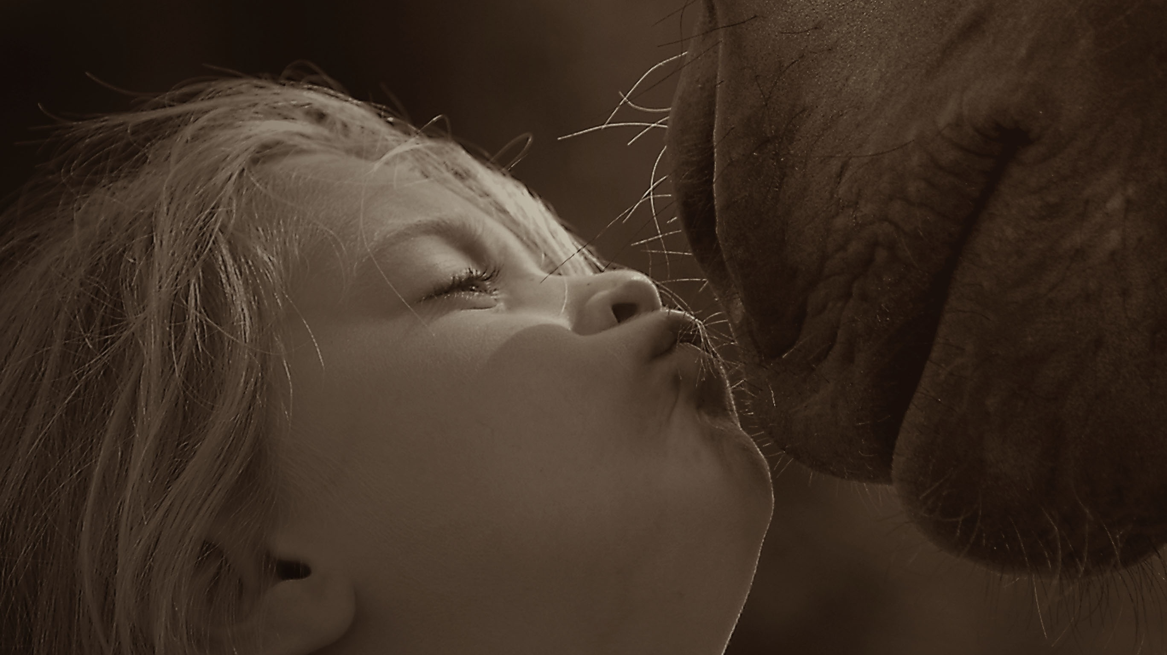

Promoting “Responsible Ownership.”
Prevention is a great way to keep horses from becoming At-Risk in the first place.
Helping owners make responsible decisions, by providing responsible choices.
Notes:
By far however, our biggest impact in creating change for at-risk horses is by starting at the source, and that’s through teaching horse owners how to be responsible for the horses in their care. This is done by educating owners about not only responsible care and responsible breeding, but through providing resources and options to help them keep their horse. Or if they can’t keep their horse, providing responsible options and alternatives for the next chapter of their life.
We also want to make sure that owners are thinking about what happens to their horse if something happens to them as an owner, so providing information regarding estate planning is also critical to that end. And then of course, helping owners understand what’s involved in end of life decisions, including euthanasia and disposal, because it will happen to every horse owner at some point in their lifetime, and if we can prepare them, it makes the topic less scary and a bit easier to understand what’s involved in the process, both when it comes to euthanasia as well as disposal.
Prevention and being a responsible horse owner is key in helping to keep most horses from reaching an at-risk state, and thereby keeping them out of the system.

Slide 19
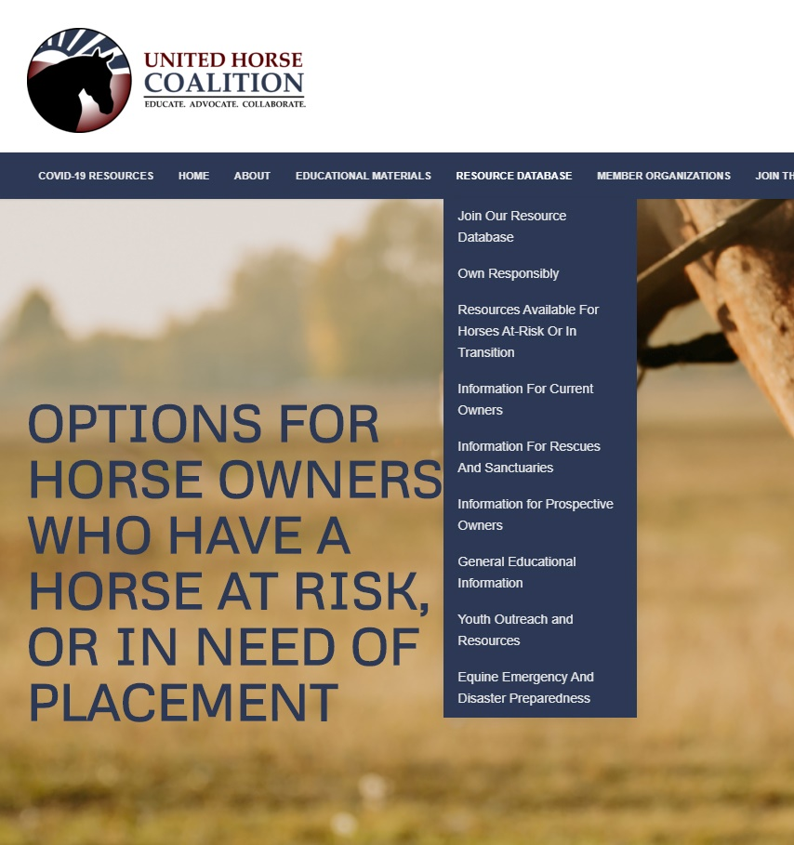
What are our resources?
Resources for Current Owners:
Resources for Prospective Owners:
Resources for Rescues and Sanctuaries:
Facilities that accept horses
Questions to ask before surrendering/retiring a horse
Feed and hay safety net programs
Castration programs and clinics
Funding for Veterinary Care
Euthanasia programs and clinics
Information on helping owners with end of life decisions
Racing Aftercare, placement, and training
Other programs
Owning Responsibly
Finding “The Right Horse”
Basic Horse Care and Costs
Alternatives to buying a horse
Is horse ownership right for me?
And other information
Guidelines for Rescues
Accreditation
Matching programs for horses and adopters
Non-Profit Management
Fundraising
Equine Welfare Grants
USTA Financial Assistance
Other programs
Notes:
A Resource is anything we can identify that could assist in helping horses at-risk, or preventing them from becoming at-risk.
There are currently 3 categories that these Resources tend to fall under: Resources for Current Owners, Resources for Prospective Owners, and Resources for Rescues and Sanctuaries.
Each of these sub categories has its own page dedicated to resources and programs specifically to help them, in addition to what we have listed on the Resource Database Page.
Sometimes, as is in the case of Resources for Rescues and Sanctuaries, we actually direct users and visitors via external links off our webpage to resources and programs that are provided by our Member organizations and partners.

Slide 20
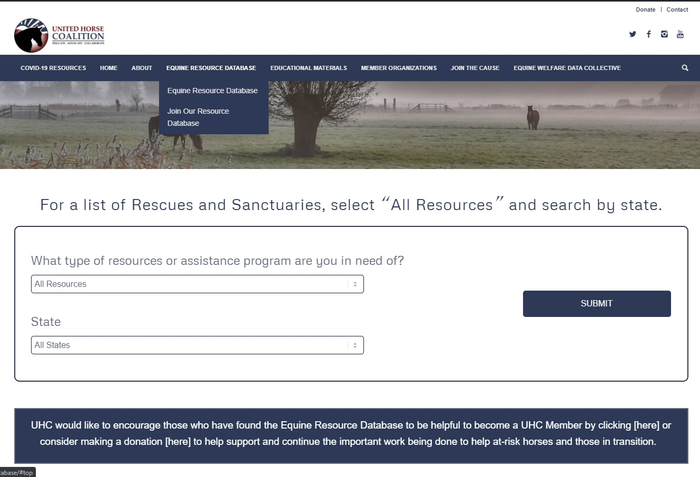
Resource Database
Searchable Database by type of resource or assistance program needed.
Notes:
By far our biggest accomplishment last year was the creation of the United Horse Coalition’s Equine Resource Database.
It’s direct impact is huge for its potential to help owners of at-risk horses.
Owners and even rescues and sanctuaries can come to our site and utilize this type of search engine to find various safety net programs or assistance programs listed by state.
New resources are being identified and will be added as they become available on a day to day basis

Slide 21
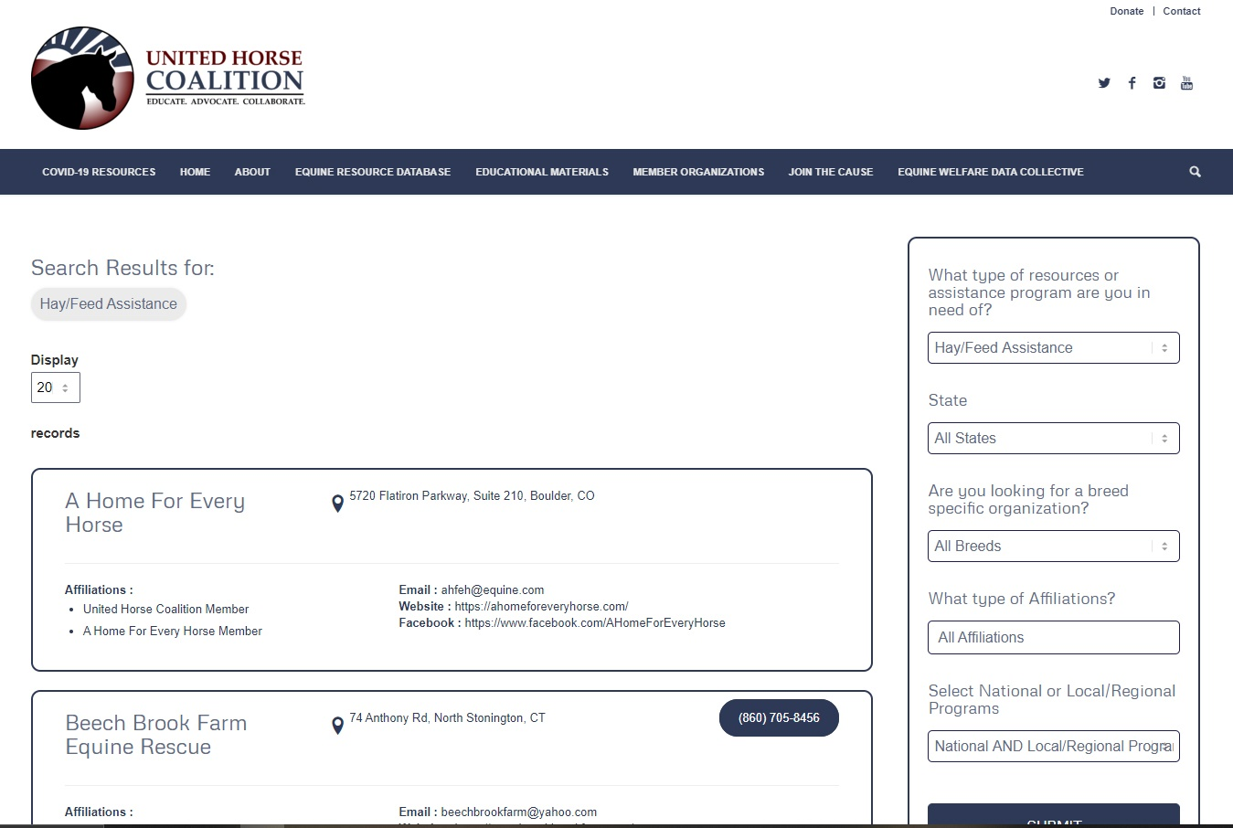
Resource Database
User can search by different filter parameters, including by state, breed specific resources national programs, or local programs.
UHC Members can help define filters that would be most useful!
Notes:
For example if an owner is in need of feed or hay assistance, they select that option from the drop down box, put in their state, and we will populate the results with any organizations that we have identified that offer that type of assistance program.
You can also search by breed specific programs or affiliations like if they are GFAS or TAA or STA accredited and so on.
The UHC Equine Resource Database is relatively flexible so we encourage members to reach out to us if you have any improvements or ideas on how we can improve its functionality.

Slide 22
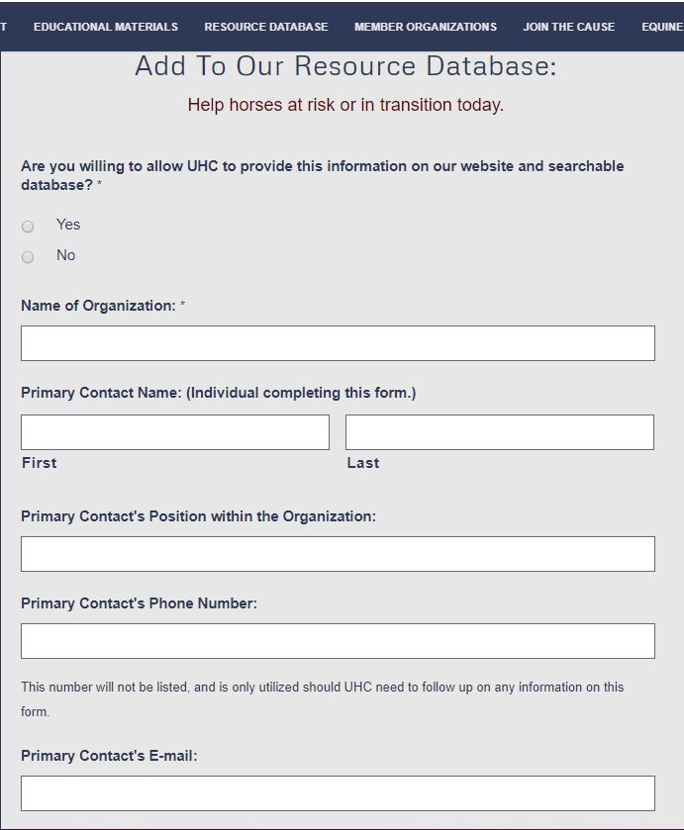
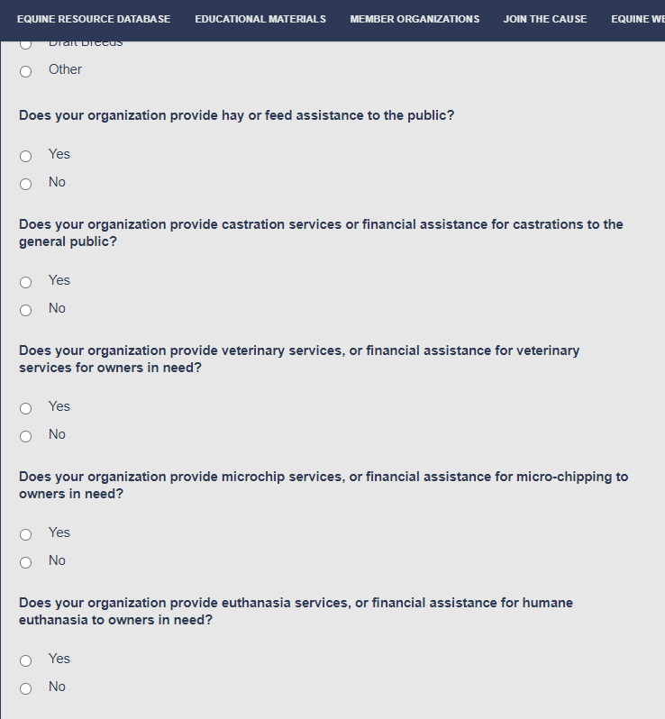
UHC RESOURCE DATABASE QUESTIONNAIRE
Being sent to:
All known equine welfare organizations nationwide
4H Groups
Extension Specialists
Veterinary Colleges and Universities
State Horse Councils
State Horse Specialists
State Veterinarians/DAR
Municipal Groups that assist with equines
Equine Industry Orgs
Notes:
There are essentially three ways UHC is adding new information to the database.
One is through the running list of 1,000 or so rescues and sanctuaries nationwide that UHC and EWDC audits.
UHC also previously had a running list of safety net programs that were located on our old website that were migrated into this database.
And lastly is through the use of the Resource Database Questionnaire which is what you see on your screen.
This questionnaire is open to anyone who may be able to provide some type of resource that can assist in helping at-risk horses.
The questionnaire was sent it out initially to groups earlier last year as a test run to work out any kinks in the database, and UHC is gearing up to send it out again this year, so be on the lookout!
It is currently being sent to all known equine welfare organizations, 4H groups, extension specialists, horse councils, municipal groups, and various industry organizations.
Essentially UHC is casting a wide net because different organizations can offer some type of assistance in some form, and even if they don’t, we’d like them to at least start thinking about maybe what they could be offering

Slide 23
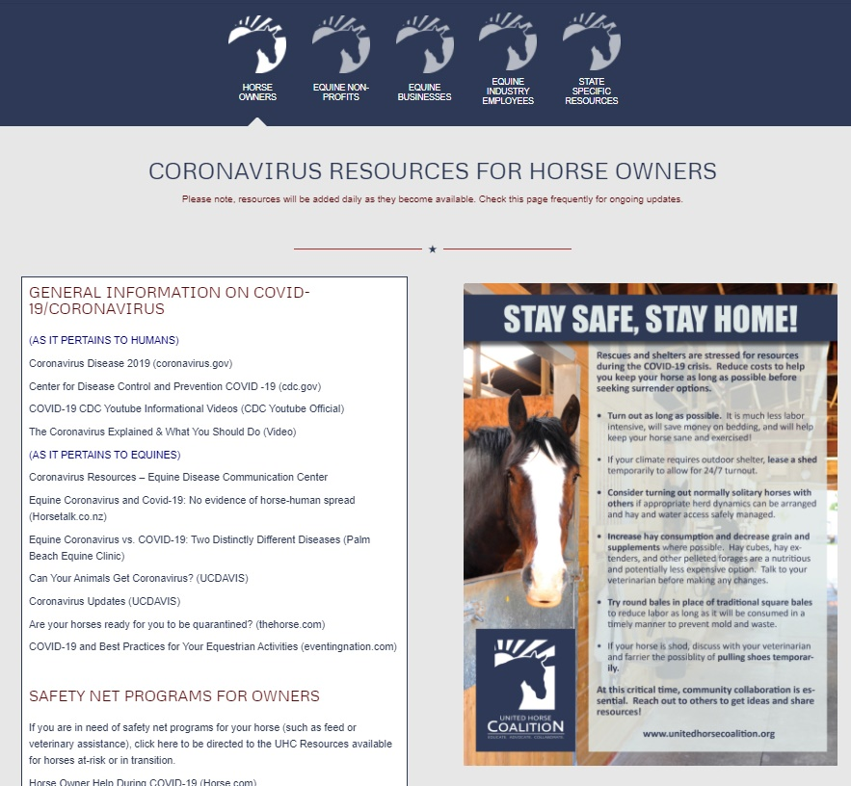
COVID-19 RESOURCES
Resources specifically for:
Horse Owners
Equine Non-Profits
Equine Businesses
Equine Industry Employees
Section for State Specific Resources
Notes:
This was UHC’s second big undertaking in 2020, but one that was equally important, as the resource database. Given that UHC acts as a hub for safety net and resource information, it was appropriate to also set up a dedicated page specifically for resources pertaining to COVID-19 relief programs.
The landing page for COVID Resources is found off the main UHC site. There are sections set up by sector, so one for Horse Owners, one for Non-Profits, one for Equine Businesses, and one for Equine Industry Employees.
In addition to this, there is a section set up for state specific resources as they come to us because each state actually has their own recommendations, as do individual barns and it does vary from facility to facility, so anything that is state specific gets posted there.
The sections themselves include links to articles, websites, information, webinars, and anything really that we find that we think will be beneficial to help aid you during this time.

Slide 24
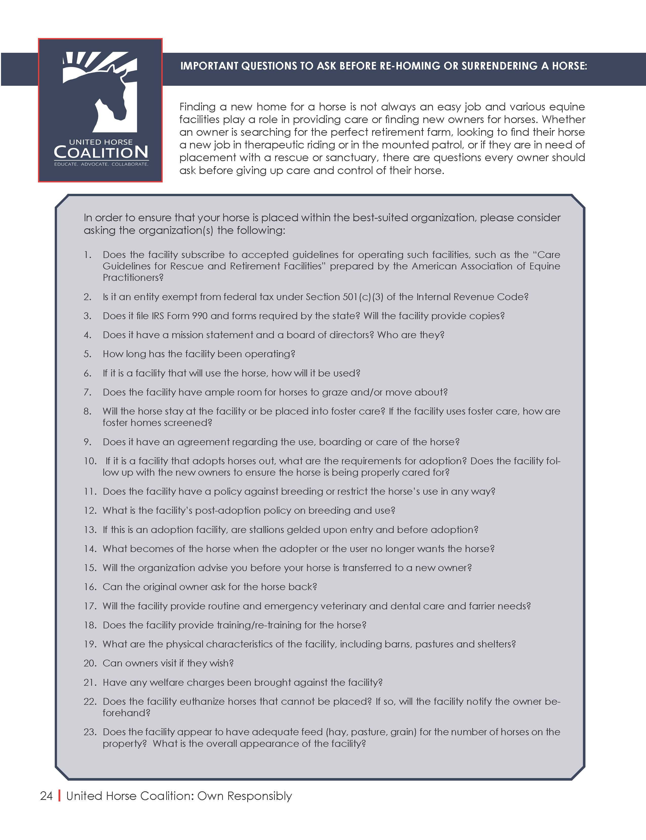
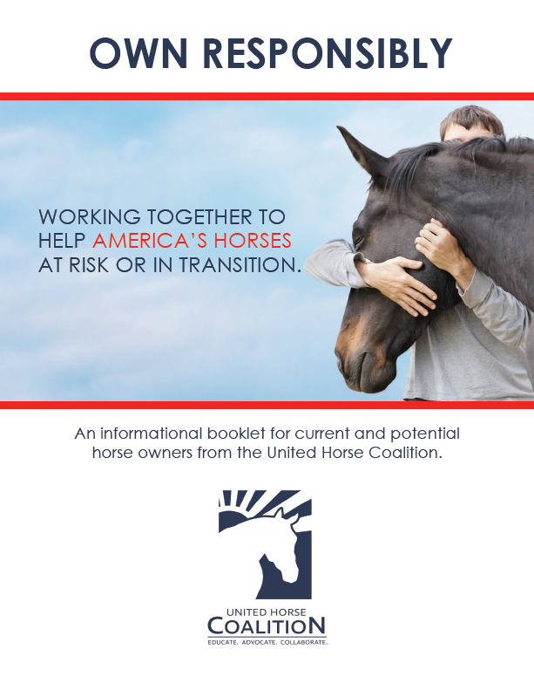
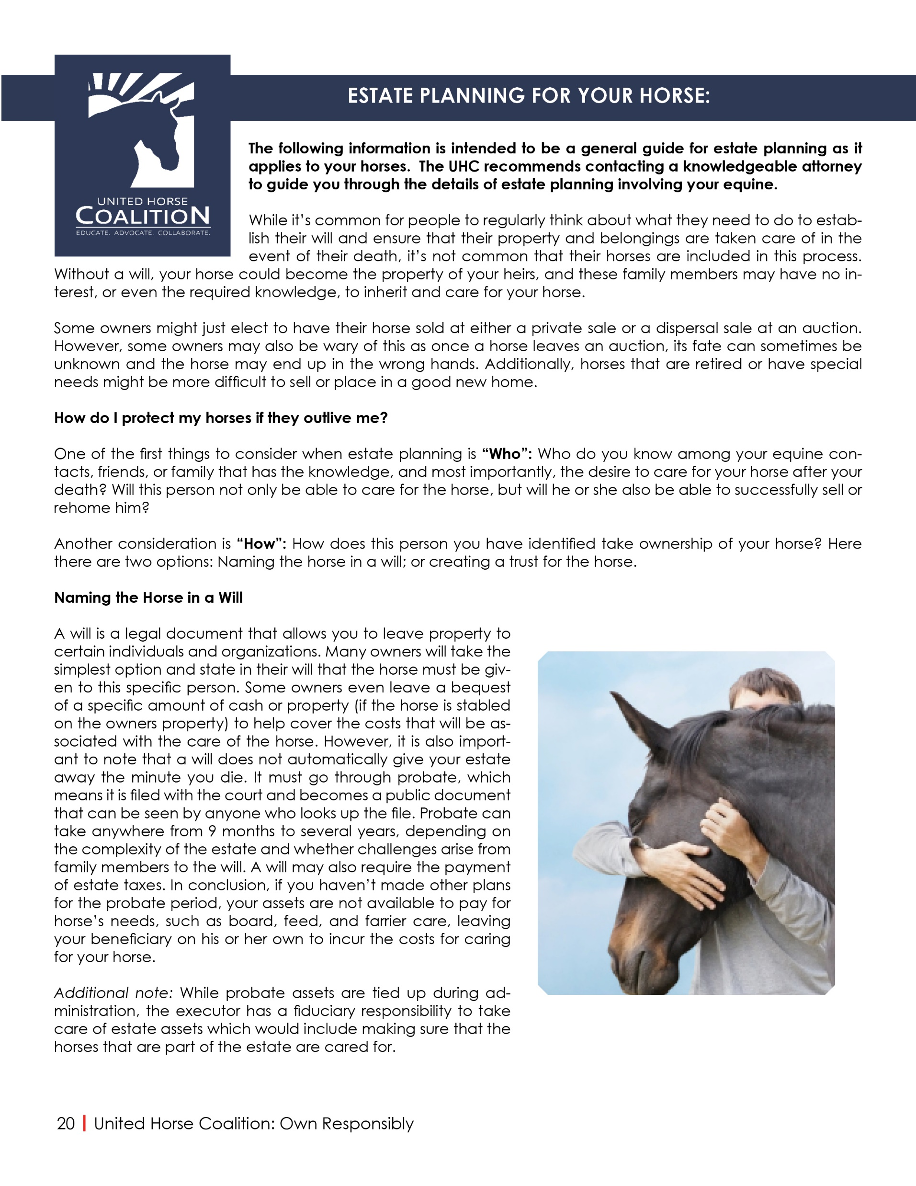
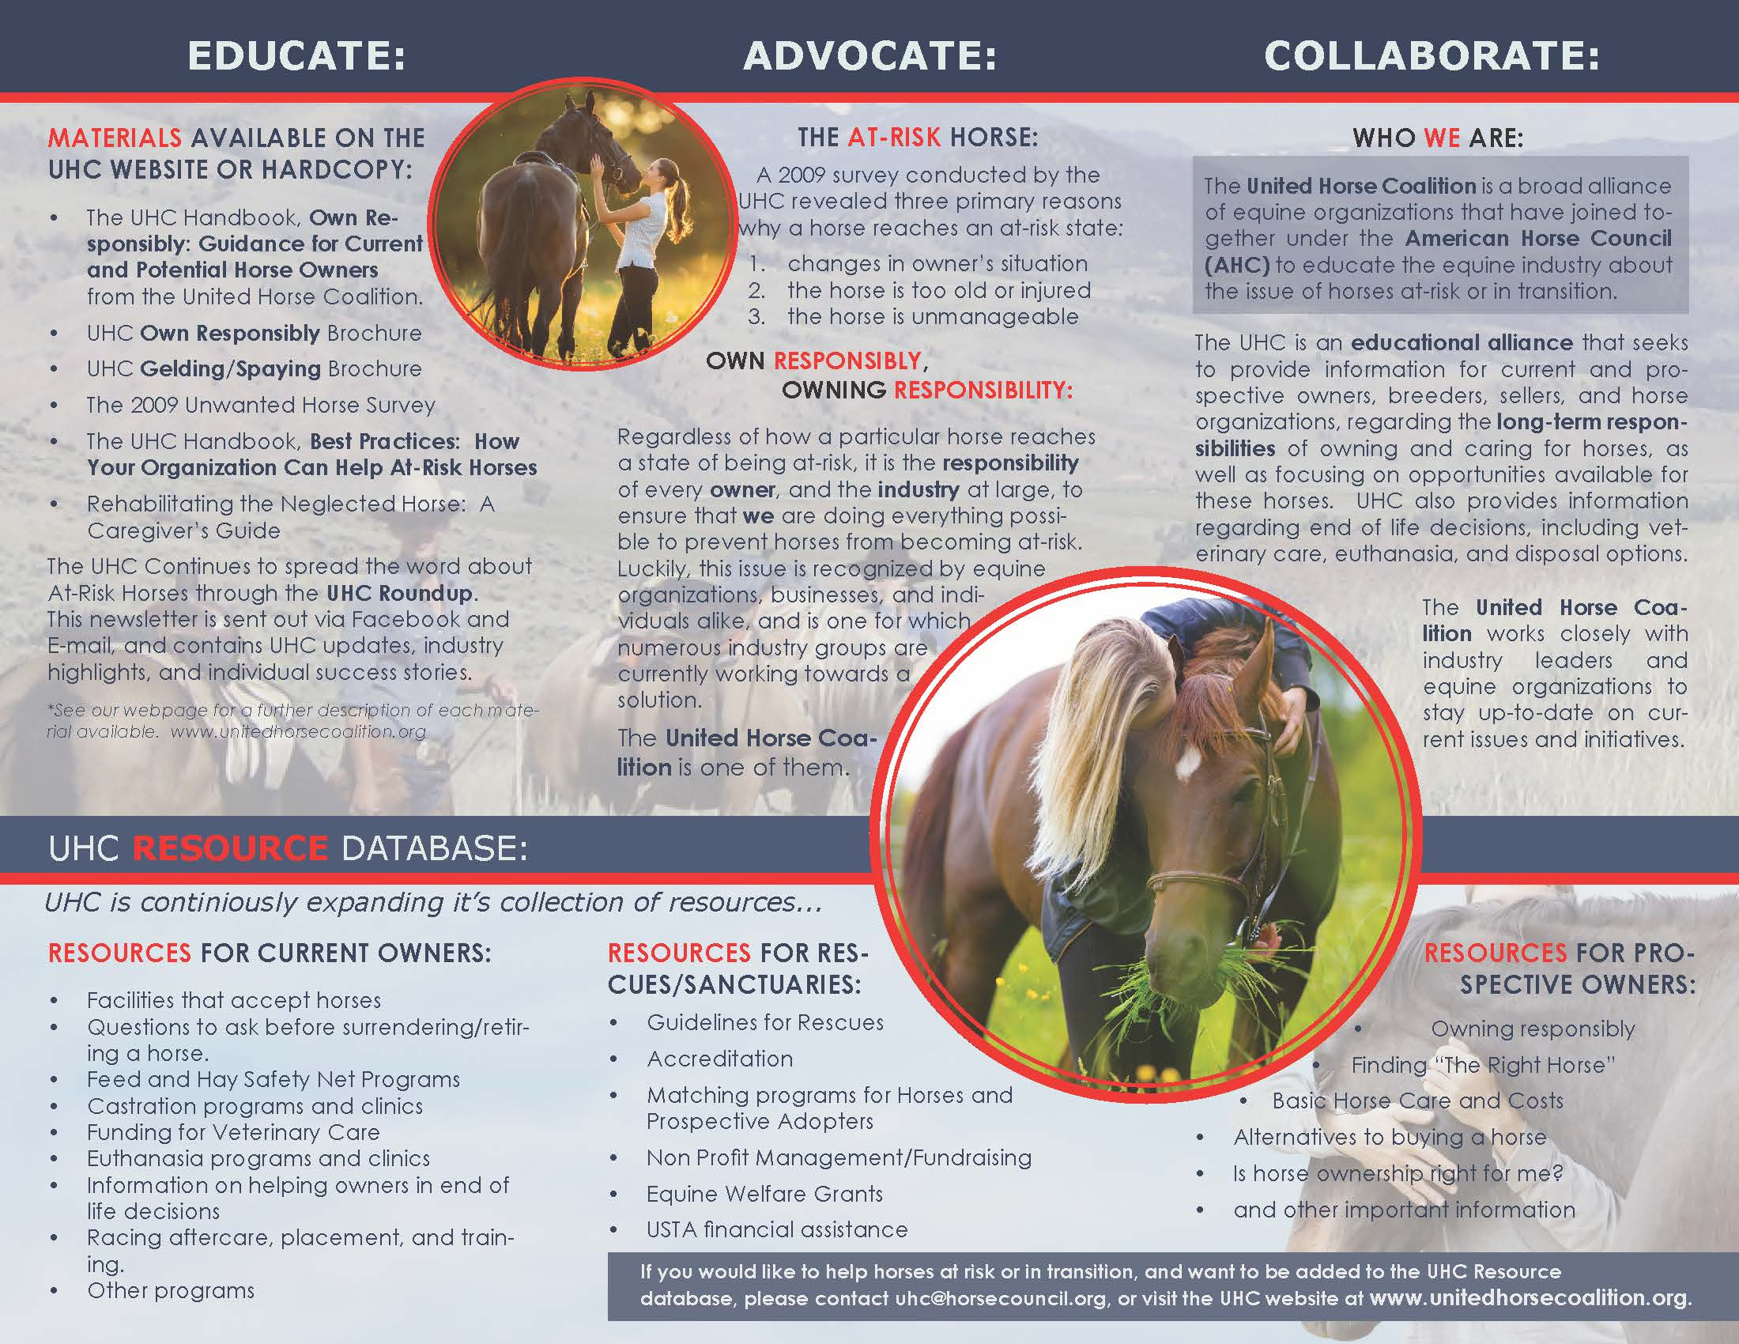
UHC Educational Materials:
Notes:
All of our Educational Materials are uploaded onto our website for our Members to utilize, as well as the general public.
Anyone is welcome to use them at events, or to pass out to your organization's clientele.
The UHC Owning Responsibly Booklet, contains all its materials and topics on Responsible Ownership of everything you wanted to know about being a Responsible Owner. It is available in PDF form for anyone to use, and we encourage you to use it! It can be a great tool for potential adopters, and new horse owners, and even current ones as there is information in there, a lot of owners haven’t thought about.
A brochure on Rehabilitating the Neglected Horse
Information on Is Horse Ownership Right for Me? Should I be taking lessons, should I try leasing first? Or am I ready to dive on in and become a horse owner?
Our Responsible Breeding brochure
Information on Finding the Right Horse, so information on how to responsibly acquire your next horse, whether you purchase or adopt.
Options for Owners Who Can No Longer Keep Their Horse
Estate Planning for Your Horse, which is something a lot of people don’t necessarily think about, but its incredibly important to do so.
Questions to Ask When Rehoming or Surrendering a Horse, because its important to research where your horse is going, does the facility have a good reputation? Do they follow any sort of welfare guidelines? Are they accredited? What is their euthanasia policy? This form is scheduled to be updated for 2021.
Information on Programs that Extend the Useful Lives of Horses, so maybe your horse can’t compete anymore, but they might be perfectly suitable for another vocation.
End of Life Decisions and Euthanasia, as well as disposal options for equines which is a such a hard topic to broach, but one that we all will come across at one point or another and having that preparation and knowledge in advance goes a long way to helping make these tough decisions a little bit easier if you are prepared for them, that way it doesn’t become something to avoid or be afraid of.
All of these materials and more are uploaded onto our website for our Members to utilize as well as the general public.

Slide 25
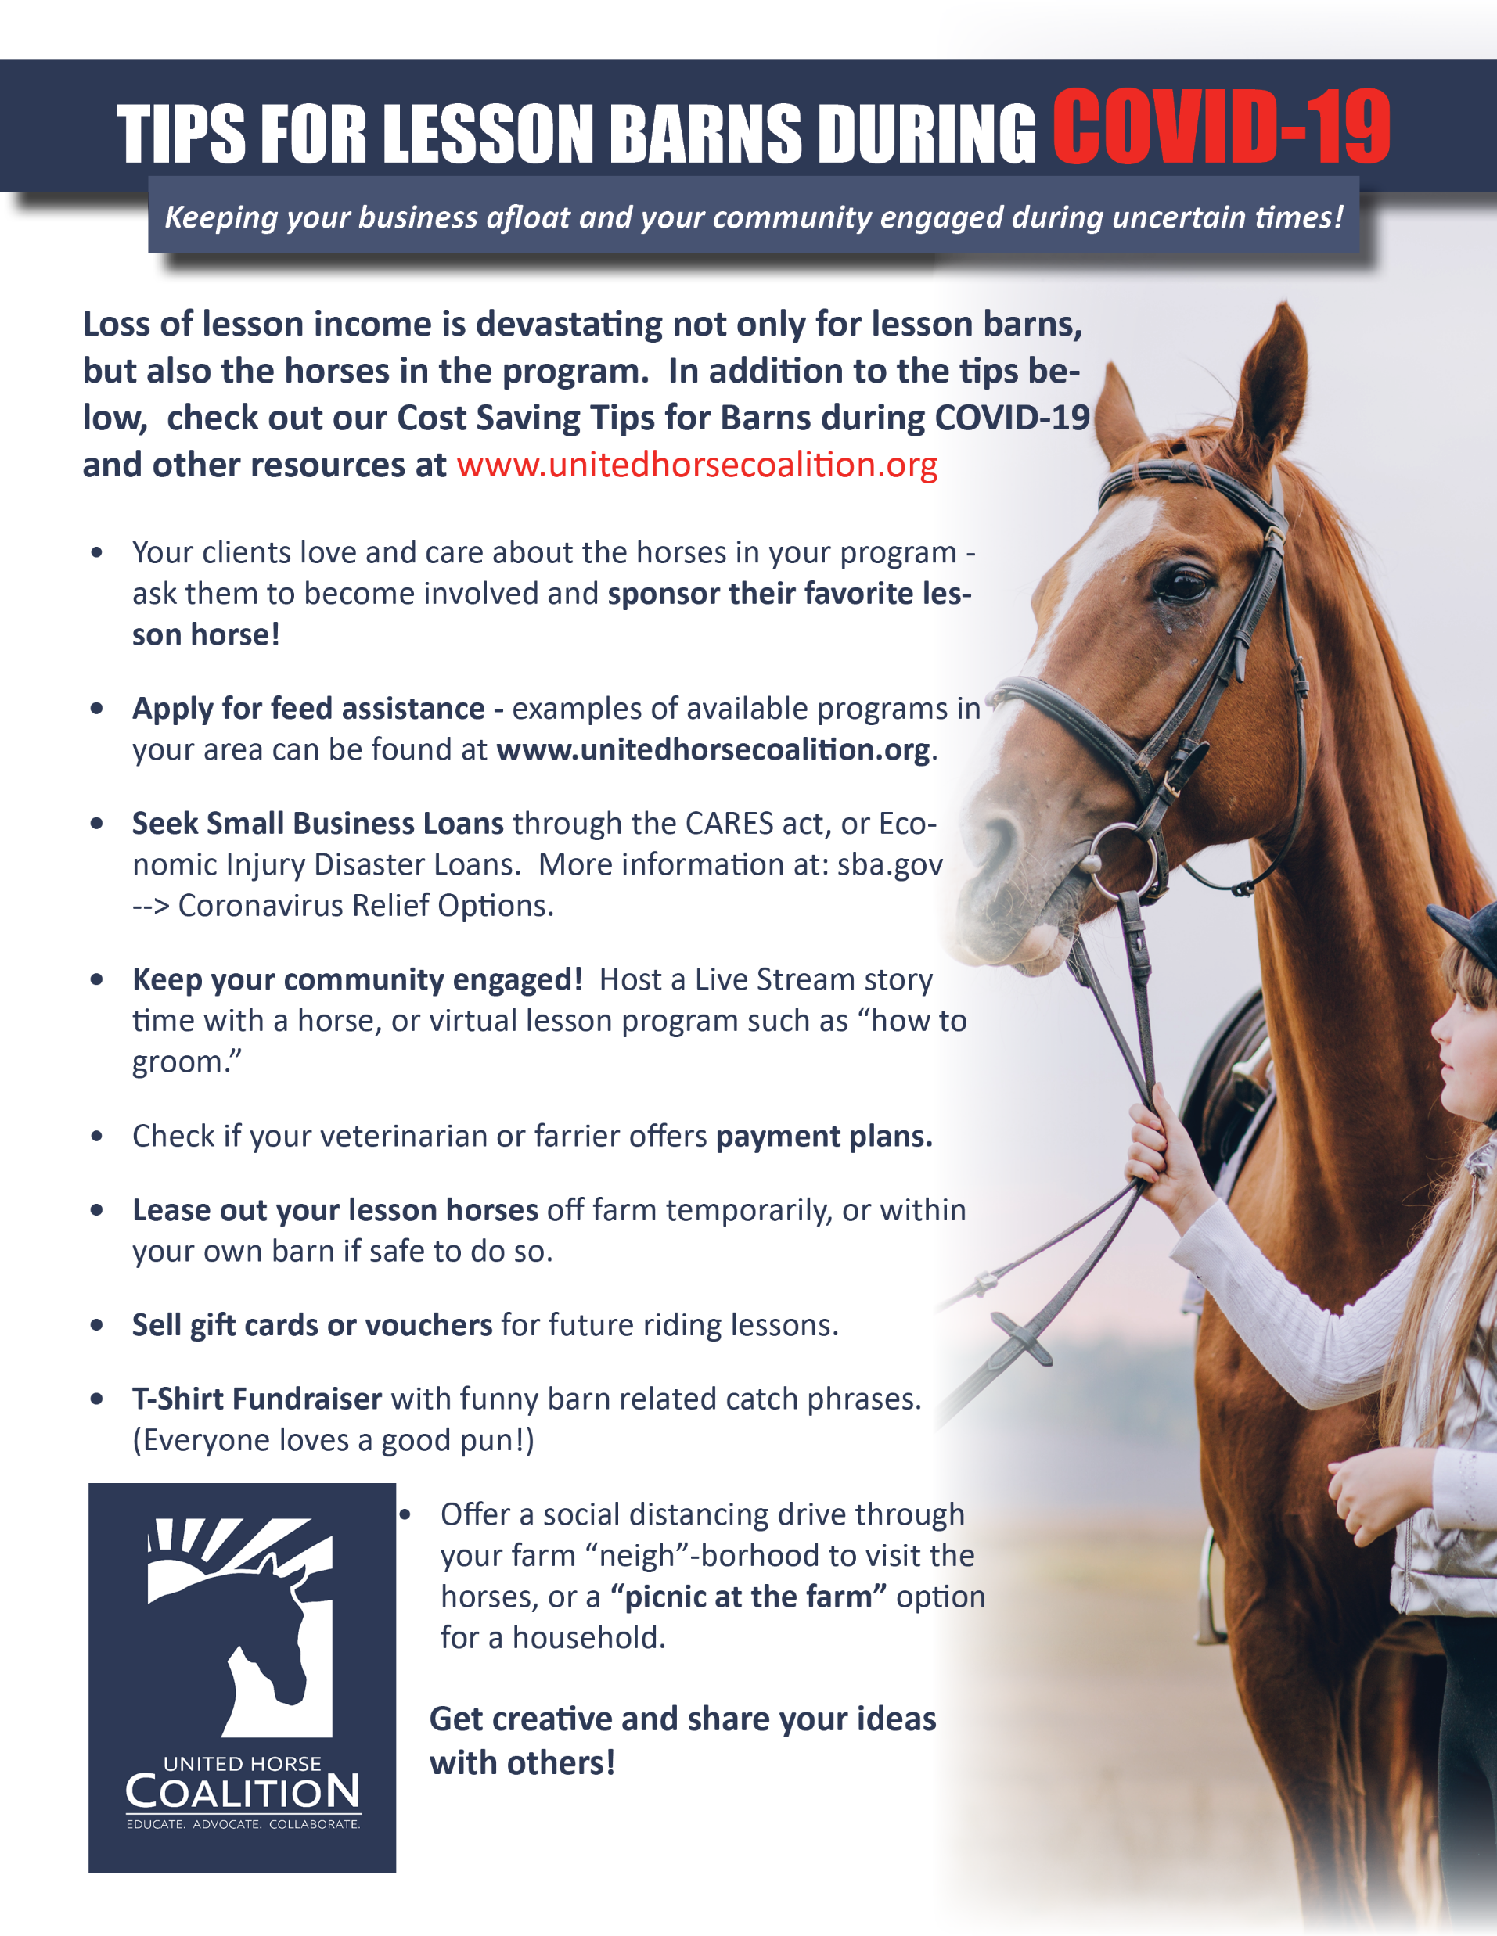
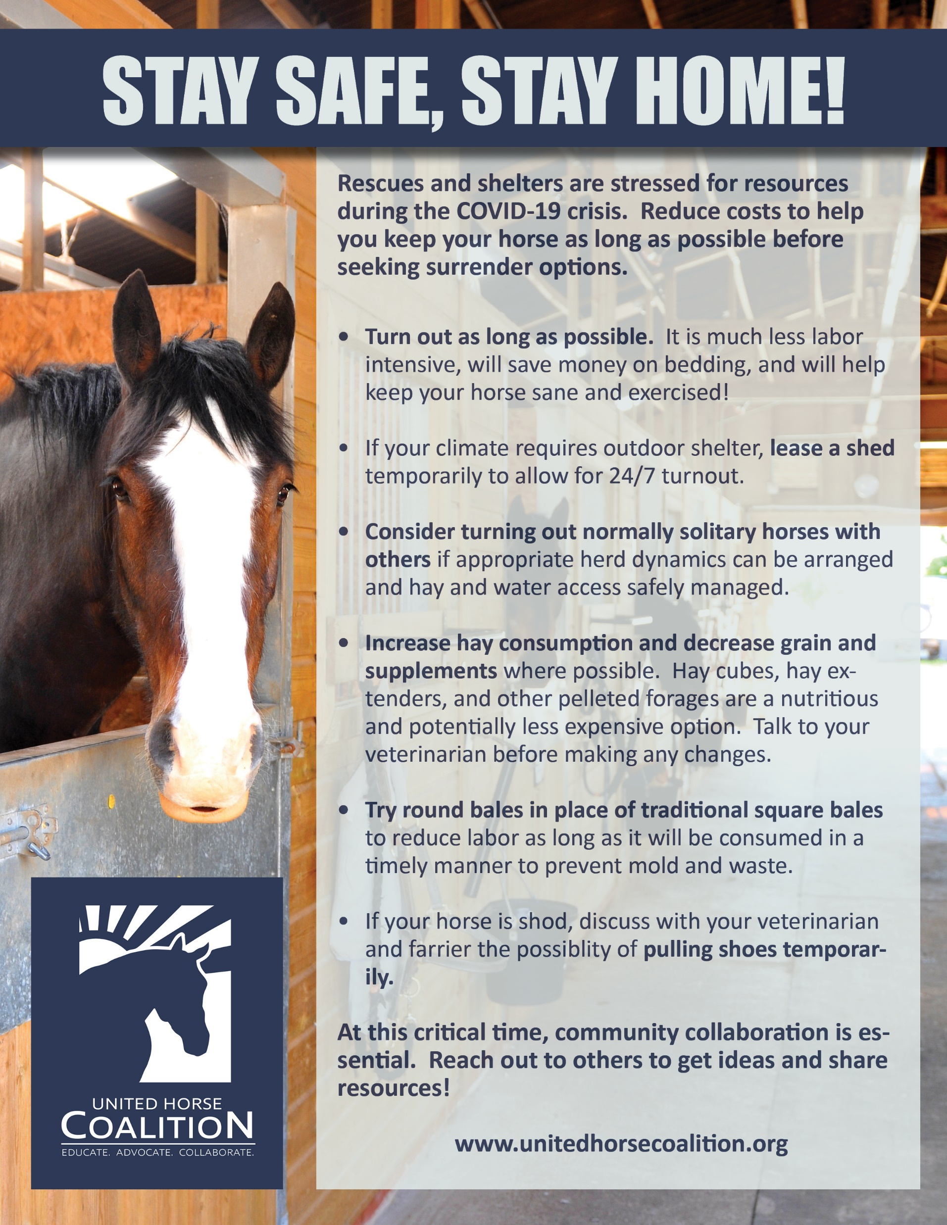
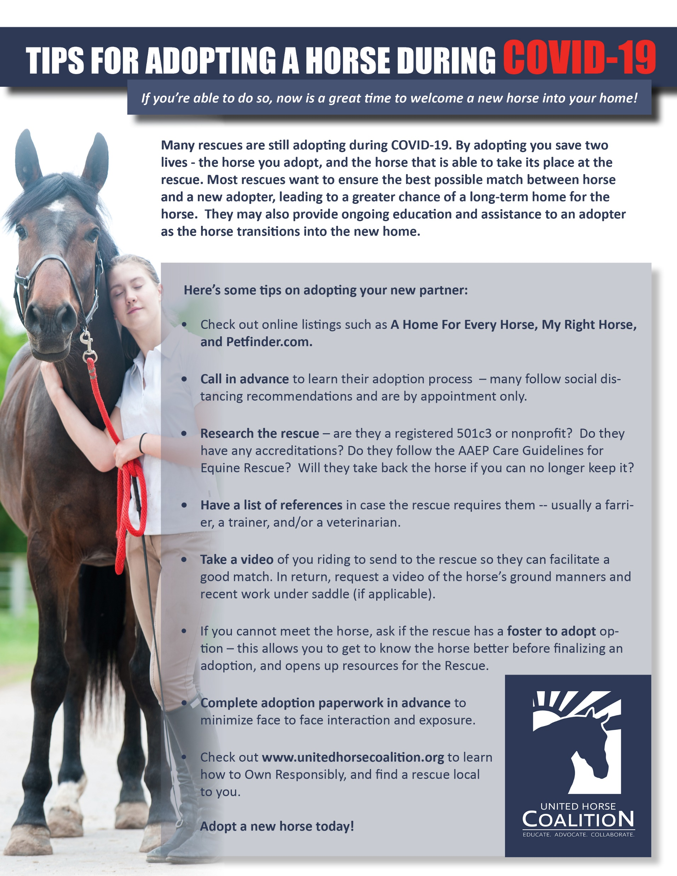
UHC Educational Materials:
Notes:
UHC also creates educational materials on an as needed basis.

Slide 26

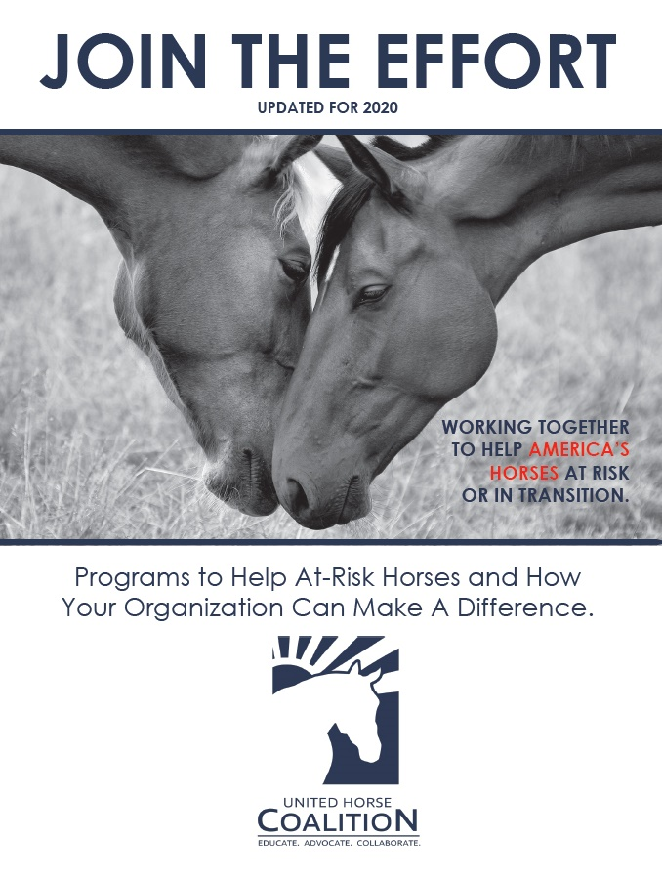
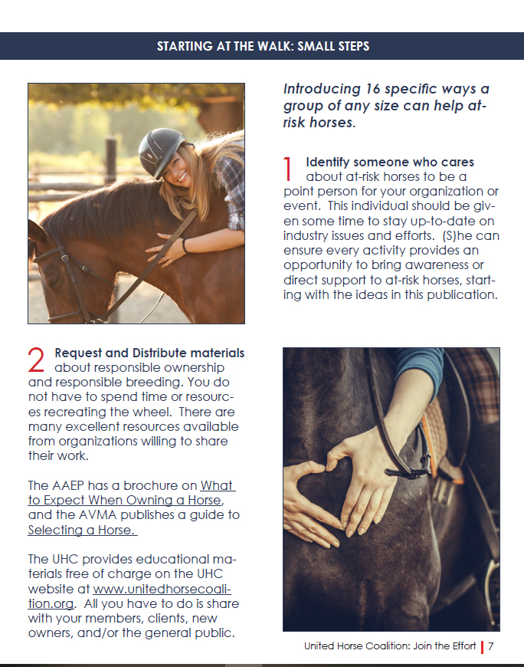
“JOIN THE EFFORT” Booklet
  Going through an update for 2021
  Also known as “Best Practices: How Your Organization Can Help.”
  A culmination of industry activities and programs available to help at-risk horses and promote Responsible Ownership
  Booklet is a living document and is meant to change and be updated as new programs and initiatives are developed.
  Revised copy will be sent to UHC Members for revisions/additions.
Notes:
Another important educational material, is the UHC Join the Effort booklet which is getting an update and an overhaul for 2021. On the UHC website this booklet has also been titled Best Practices: How your organization can help Unwanted Horses
This booklet was originally put together to help industry organizations and individuals institute activities and programs to help at-risk horses and those in transition.
It’s a means to share what other organizations and individuals are already doing, to be able to provide guidance and ideas to other organizations and individuals about how they can jump on board as well.
It’s also important to note that this document is a living document, meaning it changes as new programs are developed.

Slide 27
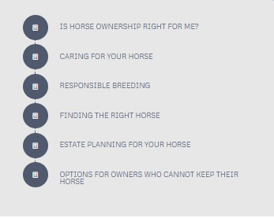
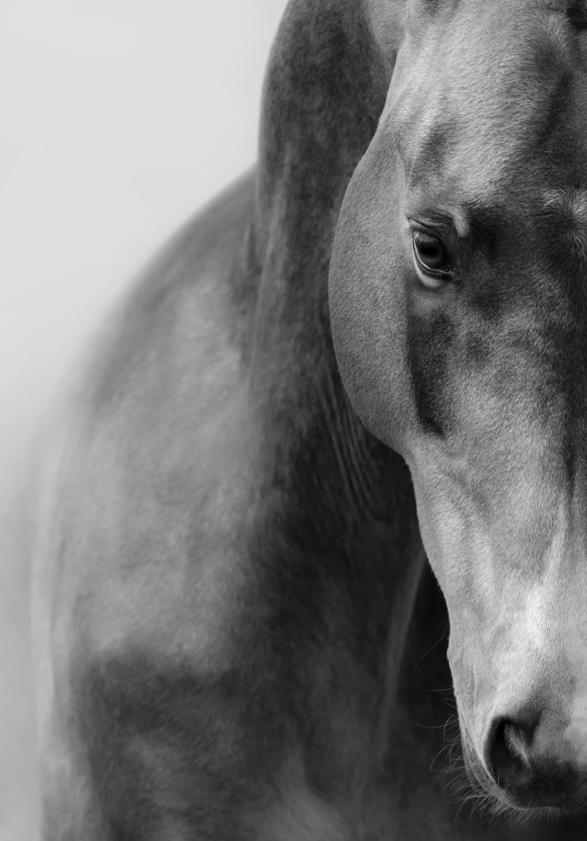
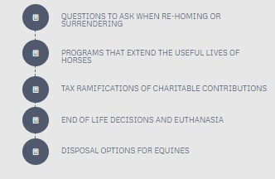
New Owner packet
(Coming 2021)
Packet filled with Responsible Ownership materials also available on our website
Available for distribution anywhere a horse changes ownership
  Adoption facilities
  Sales Barns
  Breeding Barns
  Auctions
Could also include provisions like buy back agreements, first right of refusal contracts, Full Circle programs etc.
Notes:
One of the new projects UHC is hoping to collaborate on is the creation of a new owner packet containing some form of the responsible ownership materials listed on the website.
The goal is to have these packets available for distribution anywhere a horse changes hands, so this could be at adoption facilities, sales barns, breeding barns, auctions and so on.
Theoretically these packets could also include provisions for things like example buy back agreements, first right of refusal contracts, information on microchipping and full circle programs.
The purpose is to try and promote responsible ownership before the horse changes hands so that each owner has the tools in place that they need to make responsible decisions on their horses behalf.

Slide 28
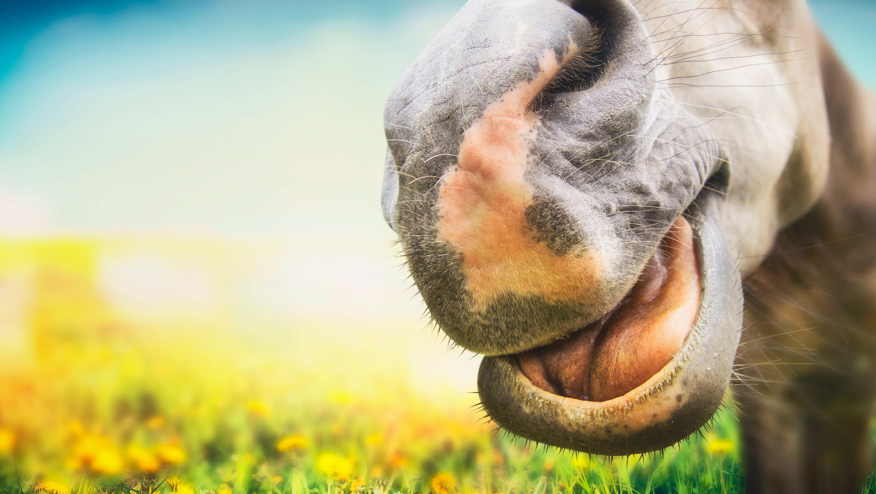
TRANSFORMING OUR EDUCATIONAL MATERIALS/INCREASING ACCESIBILITY
Replicating our educational materials into other types of mediums
Video’s, educational modules, 1-page graphics, etc.
Allows for a wider range of options to share this important information
Makes the information less dry, and more palatable for the general public and horse owners.
Notes:
UHC will also be transforming it’s educational materials into other types of mediums that might make the material a bit more palatable for the general public.
It’s hard to get someone to sit down and read a wordy pdf file!
Plans to turn the materials into short educational videos or modules.

Slide 29

Equine Welfare Data Collective
Equine Welfare Data Collective
Program Manager
Emily Stearns
EWDC@HorseCouncil.org

Slide 30
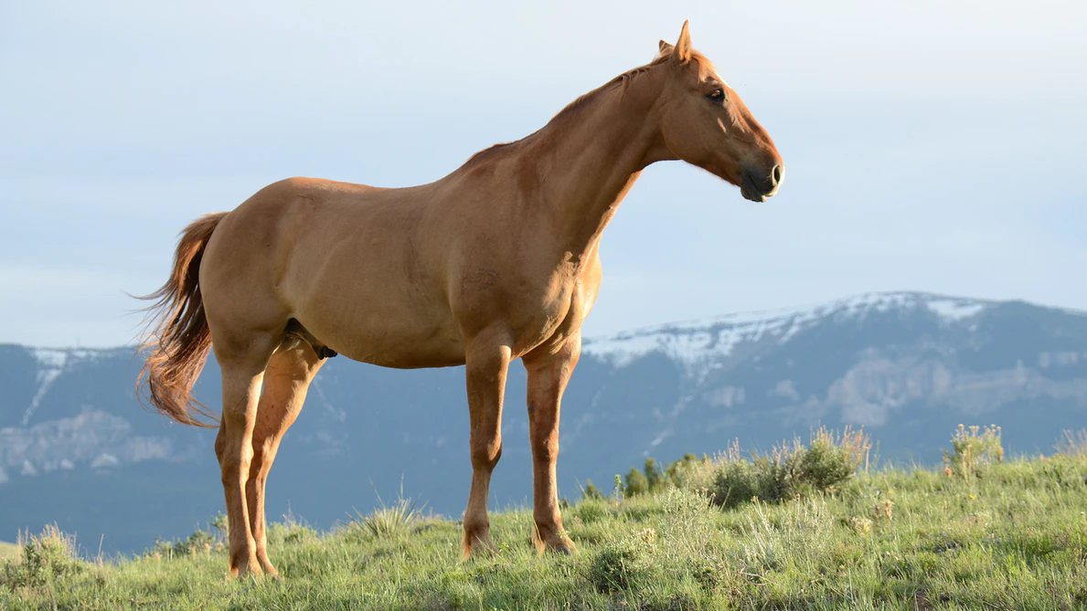
Mission
Provide rescues, sanctuaries, municipal facilities, funding agencies, certifying agencies, and all others involved in the equine community with the data necessary to evaluate and guide actions that support equines at-risk and in transition.
Notes:
Mission of the Equine Welfare Data Collective
Our overarching goal is to provide the critical data needed to drive program development, identify areas of concern, and allows equine welfare organizations, industry leaders, and municipal bodies to address needs within their community.

Slide 31
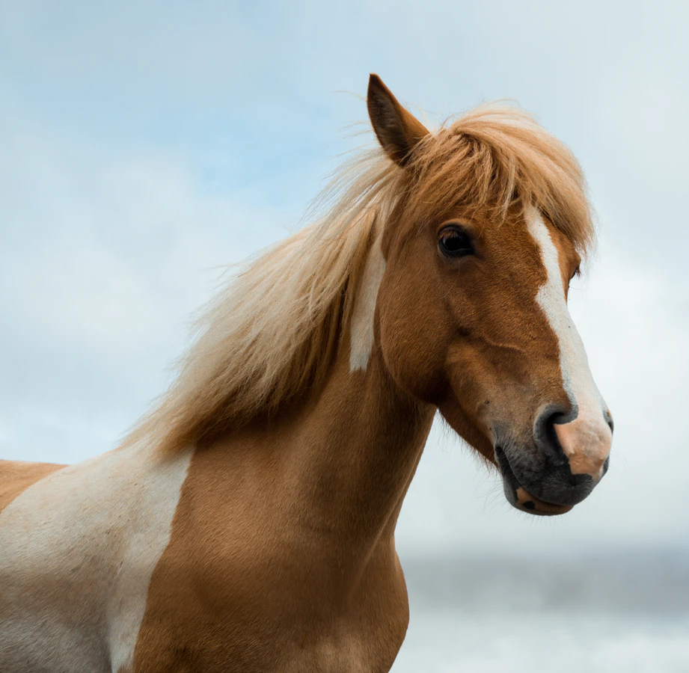
Accomplishments
Database of over 1000 equine welfare orgs
Data from 30% of equine welfare population
2 published reports
Ambassador program
Intern program
Notes:
What we do:
We used our initial research phase to build a database of all equine welfare organizations within the US that assist at-risk equines and those in transition.
Many of our data points represent over 30% of this equine welfare organization population.
Since our inception we’ve published multiple reports, available free on our website, and are constantly working on our next publication.
We’ve developed an ambassador program to engage not only the greater community equine welfare organizations, but the equine industry as a whole. EWDC Ambassadors are invited to sit in on round table discussions, share promotional materials about the EWDC, and provide crucial feedback on our data collection.
As we’ve grown we’ve needed to expand our man power, and we’ve done so by building out a robust intern program. At any point in time we have 2-3 interns that assist with participation recruitment, marketing, preliminary research (i.e. finding new orgs to add to our database), and database management.
Finally, we identified in our first report that over 50% of all equine welfare organizations rely on paper record keeping systems or a combination of spreadsheets and paper record keeping. We feel record keeping is a critical aspect of good data collection and launched an education initiative to help organization identify and begin initializing software solutions to assist them in their record keeping needs.

Slide 32
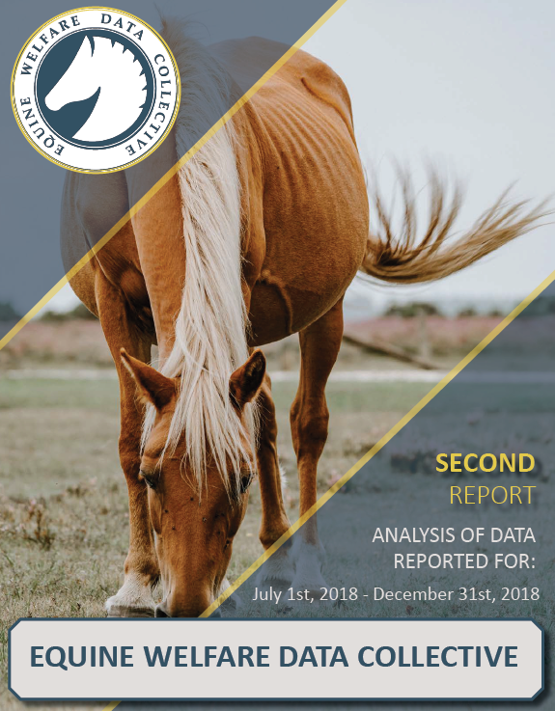
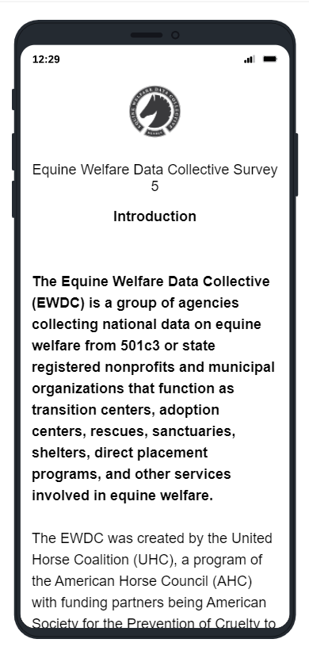
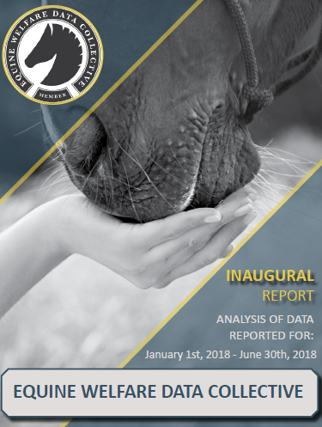
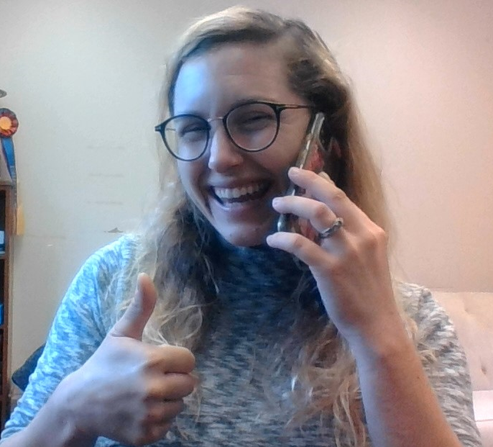
How it works
unitedhorsecoalition.org/submit-data/
Notes:
How do we collect data? Through email, telephone, and secondary recruitment through our ambassadors.
We have an online survey system that people submit data through ,and the we analyze and report that data, using a third party analyst to review our results and a second peer reviewer of the final report.
All of our report are listed for free on our website.

Slide 33
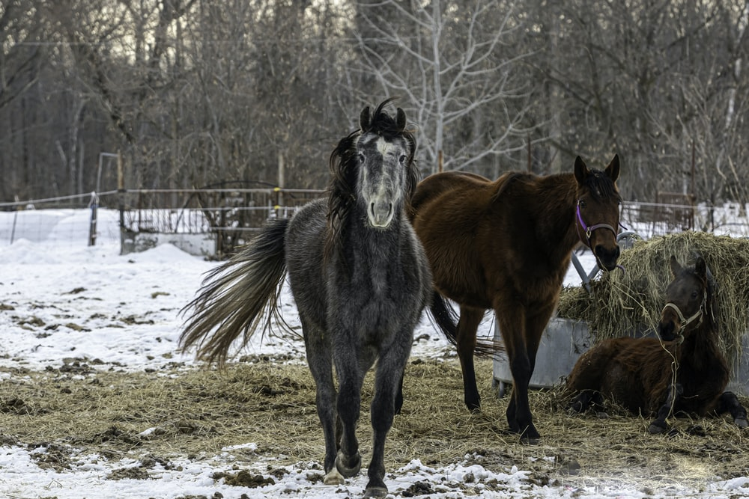
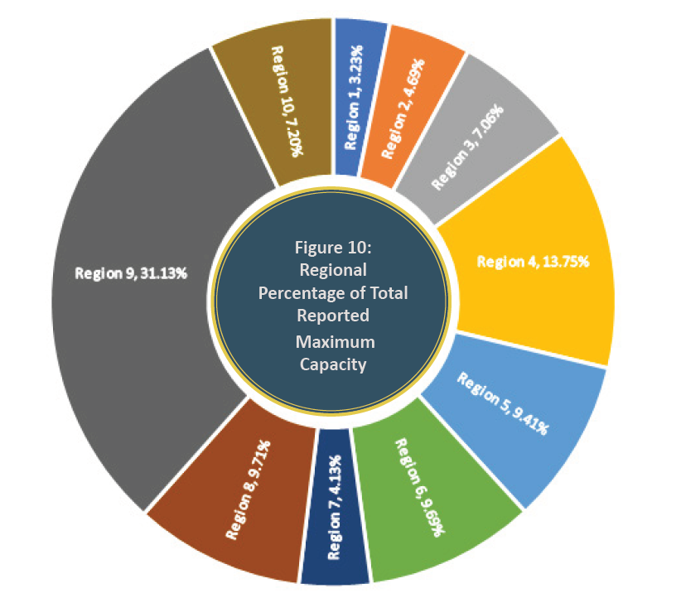
Second Report Data
Estimated Daily Max. Cap: 47,194
(95% CI, Std. Err. 4,664
L 95% 38,017 U 56,370
Accounting for outliers)
Notes:
This is a sample of the many datapoints we report on! In our second report we had a large enough sample size to be able to estimate the national daily maximum capacity (47,294 equines are able to be cared for on any one day!)

Slide 34
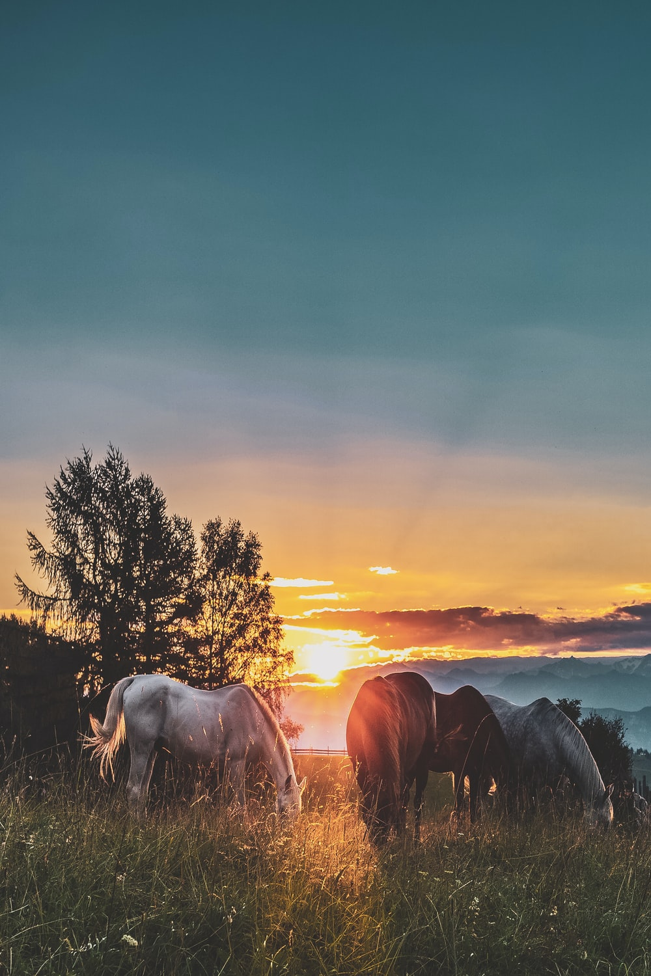
Animal Shelter Software Education
Webinar 1
Review of software geared to organizations that provide shelter/rescue support or sanctuary/retirement services.
Webinar 2
Review of software geared to organizations that provide primarily safety net and direct placement services.
Webinar 3
Fundraising and volunteer management.
All webinars recorded and available online
Notes:
Finally, we ‘re very proud of the software education initiative and received fantastic feedback from our ambassador organizations who routinely guide their affiliates to check out our recorded webinars.
All of our educational webinars are listed on our website.

Slide 35

What you can do to help at-risk horses
Own Responsibly
Have contingency plans in place for your horse
Include your horse in your Estate Planning
Breed Responsibly
Join the UHC Ambassador Program
Volunteer at rescues or rehoming facilities
Donate to UHC or your local rescue –
or help raise funds.
Share UHC materials on Responsible Ownership
Notes:
What can you do to help?
On a personal level, you can….
Own Responsibly
Have contingency plans in place for your horse
Include your horse in your Estate Planning
Breed Responsibly
Join the UHC Ambassador Program
Volunteer at rescues or rehoming facilities
Donate to UHC or your local rescue –
or help raise funds.
Share UHC materials on Responsible Ownership

Slide 36

Be part of the Solution!
Let’s work at the root of the problem together – before a horse becomes at-risk.
Learn the facts and share them with other horse owners and breeders, clubs and organizations.
Help the UHC spread the word to
“Own Responsibly”
Notes:
If you work in the horse industry, consider designating one person to spearhead the effort, and consult the UHC “Join the Effort” handbook for ideas.
One simple activity is to dedicate a small section of your website to the UHC, and resources for owners.
Most importantly, the UHC aims to find common ground and work together to prevent horses from becoming at-risk – consider becoming a member today!
Please spread the word to Own Responsibly.
Thank you.

Slide 37
Thank you for listening!
Feel free to contact UHC with any questions.
UHC@horsecouncil.org
www.unitedhorsecoalition.org
Notes:
My name is _______________. I work for ___________________, but am here today representing the United Horse Coalition through their Ambassador program. I’d like to share information about the organization and offer examples of how you can help decrease the number of at-risk horses, as well as help those who are in transition.

