Slide 1
CONTACT:
Ashley Harkins – UHC Director
UHC@horsecouncil.org
www.unitedhorsecoalition.org
Notes:
My name is _______________. I work for ___________________, but am here today representing the United Horse Coalition through their Ambassador program. I’d like to share information about the organization and offer examples of how you can help decrease the number of at-risk horses, as well as help those who are in transition.

Slide 2
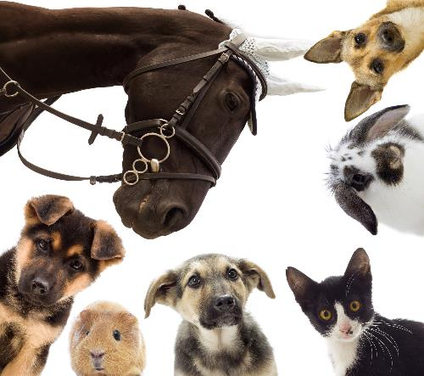
UHC History:
United Horse Coalition came about through the Unwanted Horse Summit in 2005
Key stakeholders came together to start a dialogue on the issue.
Purpose was to develop consensus on the most effective ways to address the issue surrounding horses at-risk or in transition.
In June 2006 the UHC was folded into the American Horse Council
Notes:
Originally formed in 2005 when the American Association of Equine Practitioners held a summit during AHC’s Annual Conference with other Equine Industry partners and stakeholders, with the intention of starting an open dialogue on the issues surrounding at-risk horses in America during the time.
Our original purpose was to develop consensus on the most effective way to work together as an industry to address the issues surrounding horses who were at-risk or in transition, and in June of 2006, the UHC was folded into the American Horse Council where we now operate.
We currently have over 240 member organizations involved in all facets of the Equine Industry.

Slide 3
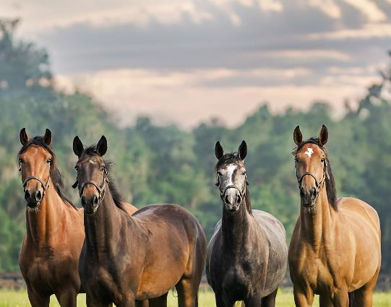
WHAT DO WE DO?
Through industry collaboration, the UHC promotes education and options for at-risk and transitioning horses.
Educated. Advocate. Collaborate.
Educational Materials on Responsible Horse Ownership.
UHC Resource Database
The Equine Welfare Data Collective
Notes:
Our mission statement states that: Through industry collaboration, the UHC promotes education and options for at-risk and transitioning horses.
And we do this by, educating current and future horse owners on responsible ownership, proper care and breeding, and options that are available to owners should they no longer be able to care for their horse, or need to re-home their horse before a horse reaches a state of being at-risk. We are raising awareness about the issues surrounding horses that are at-risk, and the impact it has on the horse industry, and hopefully reducing the number of horses at-risk, so that eventually in a perfect world, we can eliminate the issues surrounding them altogether.
We do this work mainly through education, collaboration, and advocating for at-risk horses throughout all facets of the Equine Industry. This includes promoting our educational materials on being a responsible horse owner, our UHC Equine Resource database, and the Equine Welfare Data Collective which is a program of the United Horse Coalition.

Slide 4
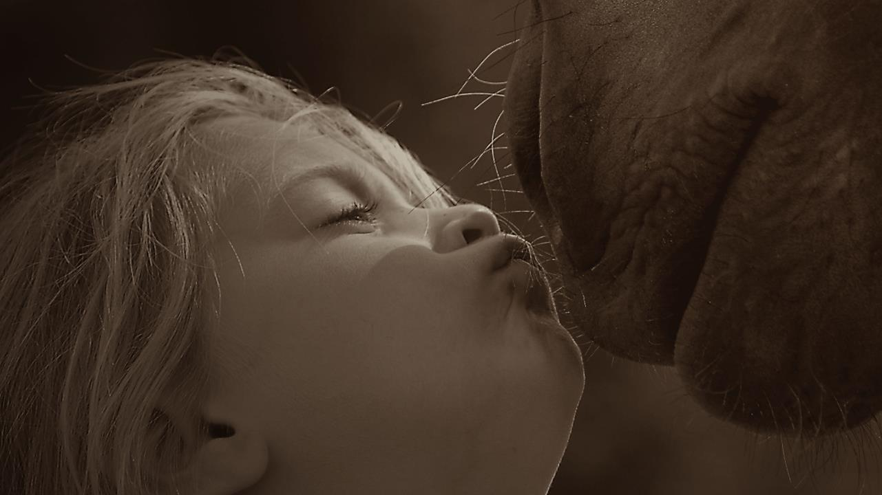
Promoting “Responsible Ownership.”
Prevention is a great way to keep horses from becoming At-Risk in the first place.
Helping owners make responsible decisions, by providing responsible choices.
Notes:
By far however, our biggest impact in creating change for at-risk horses is by starting at the source, and that’s through teaching horse owners how to be responsible for the horses in their care. This is done by educating owners about not only responsible care and responsible breeding, but through providing resources and options to help them keep their horse. Or if they can’t keep their horse, providing responsible options and alternatives for the next chapter of their life.
We also want to make sure that owners are thinking about what happens to their horse if something happens to them as an owner, so providing information regarding estate planning is also critical to that end. And then of course, helping owners understand what’s involved in end of life decisions, including euthanasia and disposal, because it will happen to every horse owner at some point in their lifetime, and if we can prepare them, it makes the topic less scary and a bit easier to understand what’s involved in the process, both when it comes to euthanasia as well as disposal.
Prevention and being a responsible horse owner is key in helping to keep most horses from reaching an at-risk state, and thereby keeping them out of the system.

Slide 5
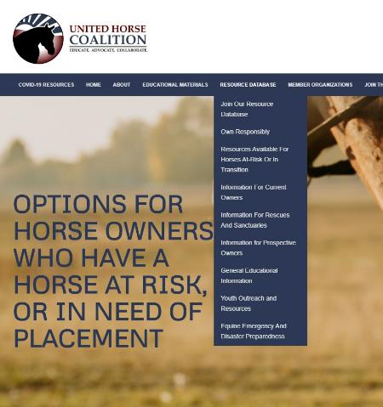
What are our resources?
Resources for Current Owners:
Resources for Prospective Owners:
Resources for Rescues and Sanctuaries:
Facilities that accept horses
Questions to ask before surrendering/retiring a horse
Feed and hay safety net programs
Castration programs and clinics
Funding for Veterinary Care
Euthanasia programs and clinics
Information on helping owners with end of life decisions
Racing Aftercare, placement, and training
Other programs
Owning Responsibly
Finding “The Right Horse”
Basic Horse Care and Costs
Alternatives to buying a horse
Is horse ownership right for me?
And other information
Guidelines for Rescues
Accreditation
Matching programs for horses and adopters
Non-Profit Management
Fundraising
Equine Welfare Grants
USTA Financial Assistance
Other programs
Notes:
A Resource is anything we can identify that could assist in helping horses at-risk, or preventing them from becoming at-risk.
There are currently 3 categories that these Resources tend to fall under: Resources for Current Owners, Resources for Prospective Owners, and Resources for Rescues and Sanctuaries.
Each of these sub categories has its own page dedicated to resources and programs specifically to help them, in addition to what we have listed on the Resource Database Page.
Sometimes, as is in the case of Resources for Rescues and Sanctuaries, we actually direct users and visitors via external links off our webpage to resources and programs that are provided by our Member organizations and partners.

Slide 6
Resource Database
Searchable Database by type of resource or assistance program needed.
Notes:
By far our biggest accomplishment last year was the creation of the United Horse Coalition’s Equine Resource Database.
It’s direct impact is huge for its potential to help owners of at-risk horses.
Owners and even rescues and sanctuaries can come to our site and utilize this type of search engine to find various safety net programs or assistance programs listed by state.
New resources are being identified and will be added as they become available on a day to day basis

Slide 7
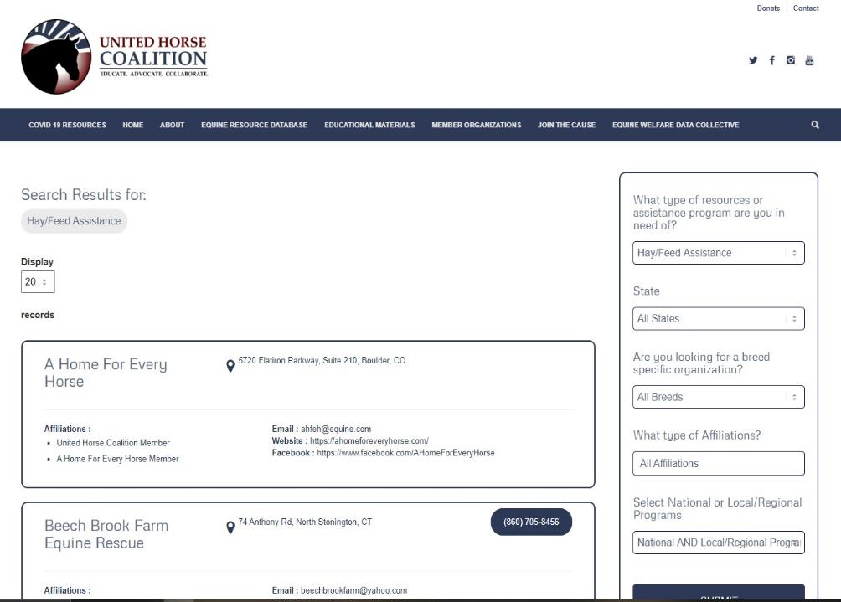
Resource Database
User can search by different filter parameters, including by state, breed specific resources national programs, or local programs.
UHC Members can help define filters that would be most useful!
Notes:
For example if an owner is in need of feed or hay assistance, they select that option from the drop down box, put in their state, and we will populate the results with any organizations that we have identified that offer that type of assistance program.
You can also search by breed specific programs or affiliations like if they are GFAS or TAA or STA accredited and so on.
The UHC Equine Resource Database is relatively flexible so we encourage members to reach out to us if you have any improvements or ideas on how we can improve its functionality.

Slide 8
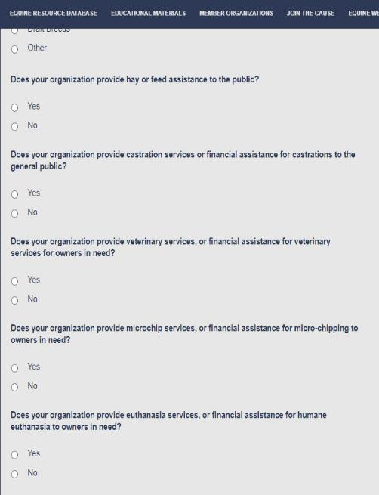
UHC RESOURCE DATABASE QUESTIONNAIRE
Being sent to:
All known equine welfare organizations nationwide
4H Groups
Extension Specialists
Veterinary Colleges and Universities
State Horse Councils
State Horse Specialists
State Veterinarians/DAR
Municipal Groups that assist with equines
Equine Industry Orgs
Notes:
There are essentially three ways UHC is adding new information to the database.
One is through the running list of 1,000 or so rescues and sanctuaries nationwide that UHC and EWDC audits.
UHC also previously had a running list of safety net programs that were located on our old website that were migrated into this database.
And lastly is through the use of the Resource Database Questionnaire which is what you see on your screen.
This questionnaire is open to anyone who may be able to provide some type of resource that can assist in helping at-risk horses.
The questionnaire was sent it out initially to groups earlier last year as a test run to work out any kinks in the database, and UHC is gearing up to send it out again this year, so be on the lookout!
It is currently being sent to all known equine welfare organizations, 4H groups, extension specialists, horse councils, municipal groups, and various industry organizations.
Essentially UHC is casting a wide net because different organizations can offer some type of assistance in some form, and even if they don’t, we’d like them to at least start thinking about maybe what they could be offering

Slide 9
COVID-19 RESOURCES
Resources specifically for:
Horse Owners
Equine Non-Profits
Equine Businesses
Equine Industry Employees
Section for State Specific Resources
Notes:
This was UHC’s second big undertaking in 2020, but one that was equally important, as the resource database. Given that UHC acts as a hub for safety net and resource information, it was appropriate to also set up a dedicated page specifically for resources pertaining to COVID-19 relief programs.
The landing page for COVID Resources is found off the main UHC site. There are sections set up by sector, so one for Horse Owners, one for Non-Profits, one for Equine Businesses, and one for Equine Industry Employees.
In addition to this, there is a section set up for state specific resources as they come to us because each state actually has their own recommendations, as do individual barns and it does vary from facility to facility, so anything that is state specific gets posted there.
The sections themselves include links to articles, websites, information, webinars, and anything really that we find that we think will be beneficial to help aid you during this time.

Slide 10
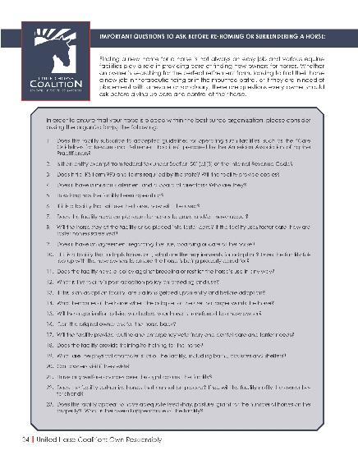
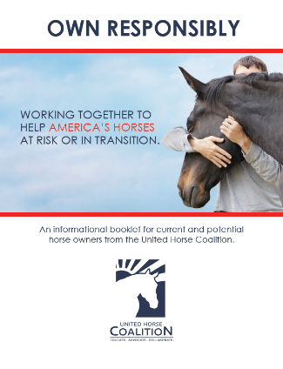
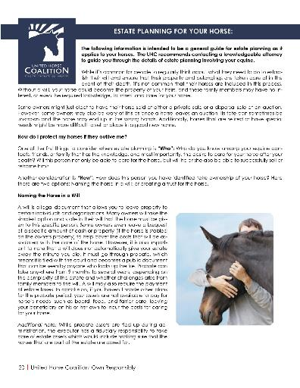
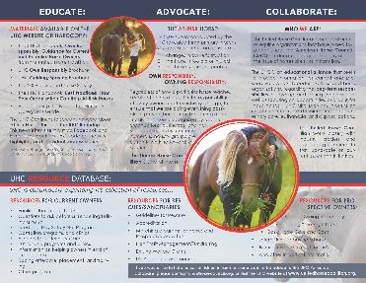
UHC Educational Materials:
Notes:
All of our Educational Materials are uploaded onto our website for our Members to utilize, as well as the general public.
Anyone is welcome to use them at events, or to pass out to your organization's clientele.
The UHC Owning Responsibly Booklet, contains all its materials and topics on Responsible Ownership of everything you wanted to know about being a Responsible Owner. It is available in PDF form for anyone to use, and we encourage you to use it! It can be a great tool for potential adopters, and new horse owners, and even current ones as there is information in there, a lot of owners haven’t thought about.
A brochure on Rehabilitating the Neglected Horse
Information on Is Horse Ownership Right for Me? Should I be taking lessons, should I try leasing first? Or am I ready to dive on in and become a horse owner?
Our Responsible Breeding brochure
Information on Finding the Right Horse, so information on how to responsibly acquire your next horse, whether you purchase or adopt.
Options for Owners Who Can No Longer Keep Their Horse
Estate Planning for Your Horse, which is something a lot of people don’t necessarily think about, but its incredibly important to do so.
Questions to Ask When Rehoming or Surrendering a Horse, because its important to research where your horse is going, does the facility have a good reputation? Do they follow any sort of welfare guidelines? Are they accredited? What is their euthanasia policy? This form is scheduled to be updated for 2021.
Information on Programs that Extend the Useful Lives of Horses, so maybe your horse can’t compete anymore, but they might be perfectly suitable for another vocation.
End of Life Decisions and Euthanasia, as well as disposal options for equines which is a such a hard topic to broach, but one that we all will come across at one point or another and having that preparation and knowledge in advance goes a long way to helping make these tough decisions a little bit easier if you are prepared for them, that way it doesn’t become something to avoid or be afraid of.
All of these materials and more are uploaded onto our website for our Members to utilize as well as the general public.

Slide 11
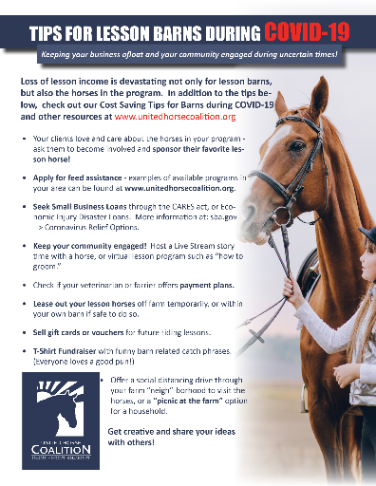
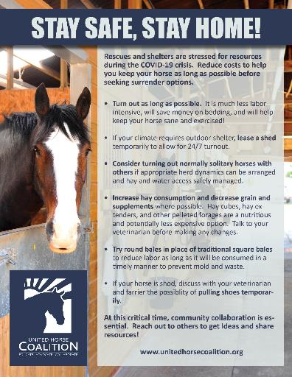
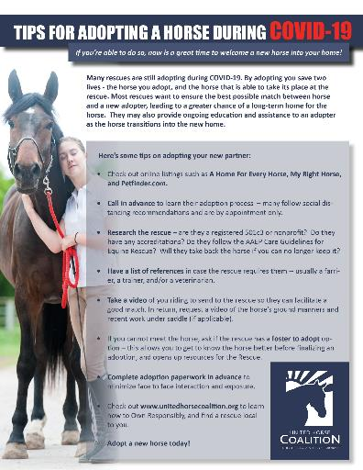
UHC Educational Materials:
Notes:
UHC also creates educational materials on an as needed basis.

Slide 12
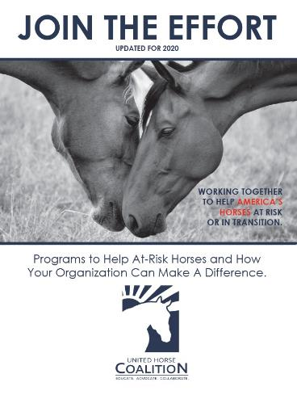
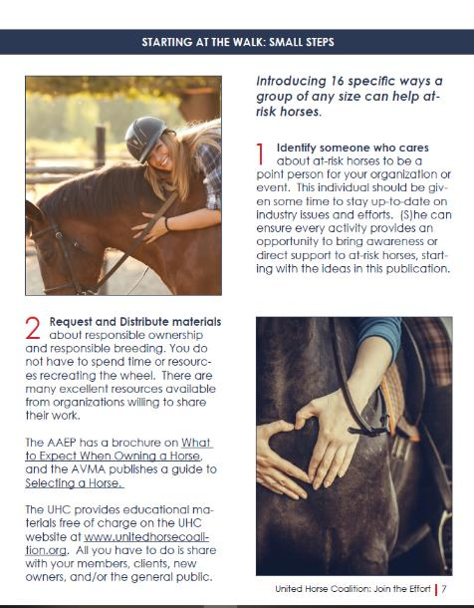
“JOIN THE EFFORT” Booklet
Going through an update for 2021
Also known as “Best Practices: How Your Organization Can Help.”
A culmination of industry activities and programs available to help at-risk horses and promote Responsible Ownership
Booklet is a living document and is meant to change and be updated as new programs and initiatives are developed.
Revised copy will be sent to UHC Members for revisions/additions.
Notes:
Another important educational material, is the UHC Join the Effort booklet which is getting an update and an overhaul for 2021. On the UHC website this booklet has also been titled Best Practices: How your organization can help Unwanted Horses
This booklet was originally put together to help industry organizations and individuals institute activities and programs to help at-risk horses and those in transition.
It’s a means to share what other organizations and individuals are already doing, to be able to provide guidance and ideas to other organizations and individuals about how they can jump on board as well.
It’s also important to note that this document is a living document, meaning it changes as new programs are developed.

Slide 13
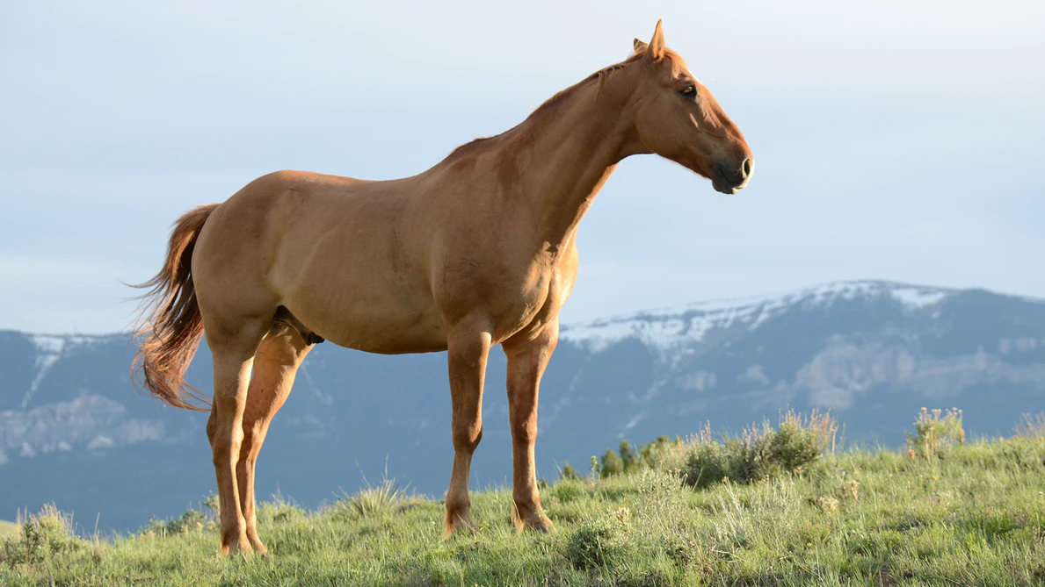
Mission
Provide rescues, sanctuaries, municipal facilities, funding agencies, certifying agencies, and all others involved in the equine community with the data necessary to evaluate and guide actions that support equines at-risk and in transition.
Notes:
Mission of the Equine Welfare Data Collective
Our overarching goal is to provide the critical data needed to drive program development, identify areas of concern, and allows equine welfare organizations, industry leaders, and municipal bodies to address needs within their community.

Slide 14
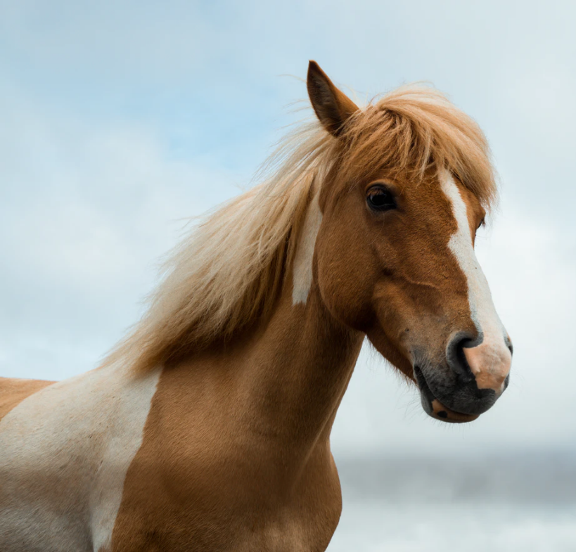
Accomplishments
Database of over 1000 equine welfare orgs
Data from 30% of equine welfare population
2 published reports
Ambassador program
Intern program
Notes:
What we do:
We used our initial research phase to build a database of all equine welfare organizations within the US that assist at-risk equines and those in transition.
Many of our data points represent over 30% of this equine welfare organization population.
Since our inception we’ve published multiple reports, available free on our website, and are constantly working on our next publication.
We’ve developed an ambassador program to engage not only the greater community equine welfare organizations, but the equine industry as a whole. EWDC Ambassadors are invited to sit in on round table discussions, share promotional materials about the EWDC, and provide crucial feedback on our data collection.
As we’ve grown we’ve needed to expand our man power, and we’ve done so by building out a robust intern program. At any point in time we have 2-3 interns that assist with participation recruitment, marketing, preliminary research (i.e. finding new orgs to add to our database), and database management.
Finally, we identified in our first report that over 50% of all equine welfare organizations rely on paper record keeping systems or a combination of spreadsheets and paper record keeping. We feel record keeping is a critical aspect of good data collection and launched an education initiative to help organization identify and begin initializing software solutions to assist them in their record keeping needs.

Slide 15
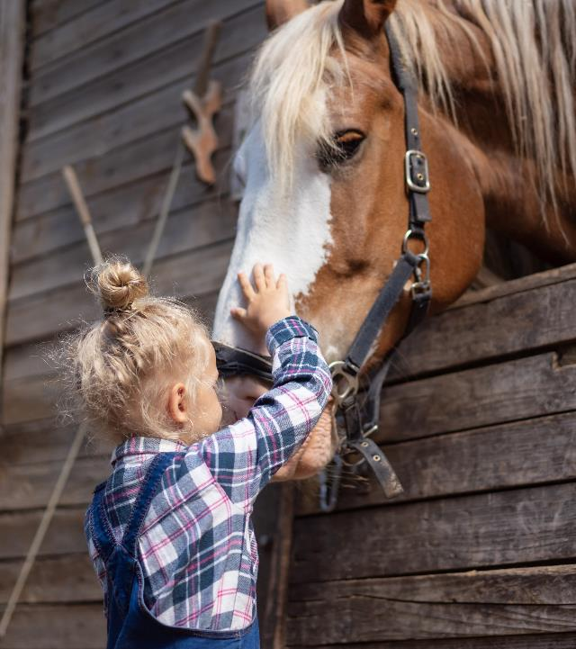
What you can do to help at-risk horses
Own Responsibly
Have contingency plans in place for your horse
Include your horse in your Estate Planning
Breed Responsibly
Join the UHC Ambassador Program
Volunteer at rescues or rehoming facilities
Donate to UHC or your local rescue – or help raise funds.
Share UHC materials on Responsible Ownership
Notes:
So to wrap things up, we’d like to go over some of the things you can do on a personal level to help at-risk horses, or even your own horse.
Own Responsibly
Have contingency plans in place for your horse
Include your horse in your Estate Planning
Breed Responsibly
Join the UHC Ambassador Program
Volunteer at rescues or rehoming facilities
Donate to UHC or your local rescue – or help raise funds.
Share UHC materials on Responsible Ownership

Slide 16
Be part of the Solution!
Let’s work at the root of the problem together – before a horse becomes at-risk.
Learn the facts and share them with other horse owners and breeders, clubs and organizations.
Help the UHC spread the word to “Own Responsibly”
Notes:
If you work in the horse industry, consider designating one person to spearhead the effort, and consult the UHC “Join the Effort” handbook for ideas.
One simple activity is to dedicate a small section of your website to the UHC, and resources for owners.
Most importantly, the UHC aims to find common ground and work together to prevent horses from becoming at-risk – consider becoming a member today!
Please spread the word to Own Responsibly.
Thank you.

Slide 17
Thank you for listening!
Feel free to contact UHC with any questions.
UHC@horsecouncil.org
www.unitedhorsecoalition.org

