Slide 1
CONTACT:
Ashley Harkins – UHC Director
UHC@horsecouncil.org
www.unitedhorsecoalition.org
Notes:
My name is _______________. I work for ___________________, but am here today representing the United Horse Coalition through their Ambassador program. I’d like to share information about the organization and offer examples of how you can help decrease the number of at-risk horses, as well as help those who are in transition.

Slide 2
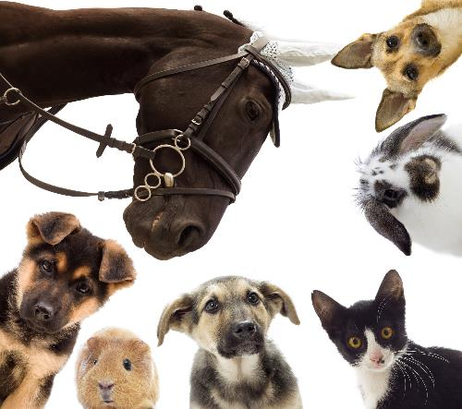
UHC History:
United Horse Coalition came about through the Unwanted Horse Summit in 2005
Key stakeholders came together to start a dialogue on the issue.
Purpose was to develop consensus on the most effective ways to address the issue surrounding horses at-risk or in transition.
In June 2006 the UHC was folded into the American Horse Council
Notes:
Originally formed in 2005 when the American Association of Equine Practitioners held a summit during AHC’s Annual Conference with other Equine Industry partners and stakeholders, with the intention of starting an open dialogue on the issues surrounding at-risk horses in America during the time.
Our original purpose was to develop consensus on the most effective way to work together as an industry to address the issues surrounding horses who were at-risk or in transition, and in June of 2006, the UHC was folded into the American Horse Council where we now operate.
We currently have over 240 member organizations involved in all facets of the Equine Industry.

Slide 3
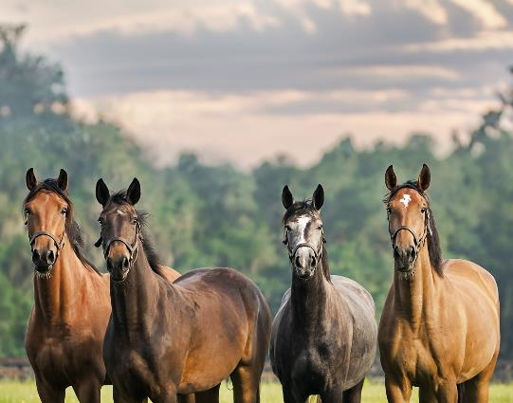
WHAT DO WE DO?
Through industry collaboration, the UHC promotes education and options for at-risk and transitioning horses.
Educated. Advocate. Collaborate.
Educational Materials on Responsible Horse Ownership.
UHC Resource Database
The Equine Welfare Data Collective
Notes:
Our mission statement states that: Through industry collaboration, the UHC promotes education and options for at-risk and transitioning horses.
And we do this by, educating current and future horse owners on responsible ownership, proper care and breeding, and options that are available to owners should they no longer be able to care for their horse, or need to re-home their horse before a horse reaches a state of being at-risk. We are raising awareness about the issues surrounding horses that are at-risk, and the impact it has on the horse industry, and hopefully reducing the number of horses at-risk, so that eventually in a perfect world, we can eliminate the issues surrounding them altogether.
We do this work mainly through education, collaboration, and advocating for at-risk horses throughout all facets of the Equine Industry. This includes promoting our educational materials on being a responsible horse owner, our UHC Equine Resource database, and the Equine Welfare Data Collective which is a program of the United Horse Coalition.

Slide 4
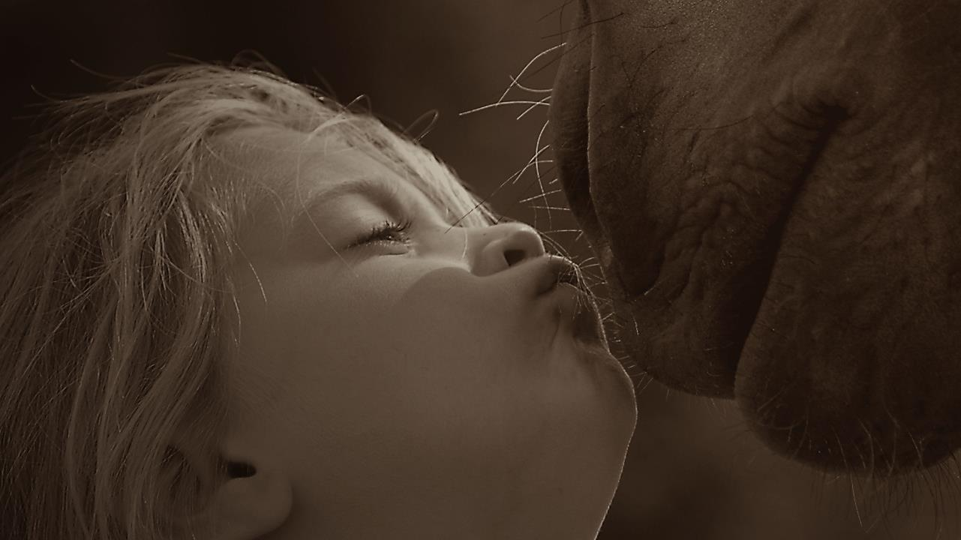
Promoting “Responsible Ownership.”
Prevention is a great way to keep horses from becoming At-Risk in the first place.
Helping owners make responsible decisions, by providing responsible choices.
Notes:
By far however, our biggest impact in creating change for at-risk horses is by starting at the source, and that’s through teaching horse owners how to be responsible for the horses in their care. This is done by educating owners about not only responsible care and responsible breeding, but through providing resources and options to help them keep their horse. Or if they can’t keep their horse, providing responsible options and alternatives for the next chapter of their life.
We also want to make sure that owners are thinking about what happens to their horse if something happens to them as an owner, so providing information regarding estate planning is also critical to that end. And then of course, helping owners understand what’s involved in end of life decisions, including euthanasia and disposal, because it will happen to every horse owner at some point in their lifetime, and if we can prepare them, it makes the topic less scary and a bit easier to understand what’s involved in the process, both when it comes to euthanasia as well as disposal.
Prevention and being a responsible horse owner is key in helping to keep most horses from reaching an at-risk state, and thereby keeping them out of the system.

Slide 5
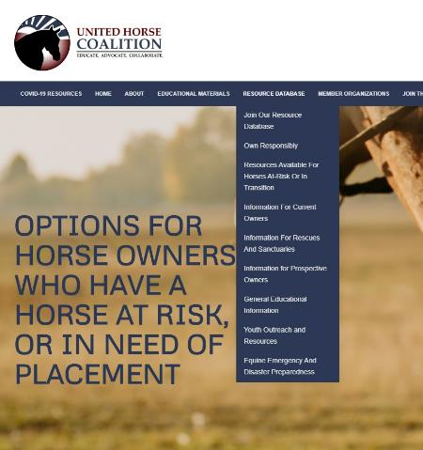
What are our resources?
Resources for Current Owners:
Resources for Prospective Owners:
Resources for Rescues and Sanctuaries:
Facilities that accept horses
Questions to ask before surrendering/retiring a horse
Feed and hay safety net programs
Castration programs and clinics
Funding for Veterinary Care
Euthanasia programs and clinics
Information on helping owners with end of life decisions
Racing Aftercare, placement, and training
Other programs
Owning Responsibly
Finding “The Right Horse”
Basic Horse Care and Costs
Alternatives to buying a horse
Is horse ownership right for me?
And other information
Guidelines for Rescues
Accreditation
Matching programs for horses and adopters
Non-Profit Management
Fundraising
Equine Welfare Grants
USTA Financial Assistance
Other programs
Notes:
A Resource is anything we can identify that could assist in helping horses at-risk, or preventing them from becoming at-risk.
There are currently 3 categories that these Resources tend to fall under: Resources for Current Owners, Resources for Prospective Owners, and Resources for Rescues and Sanctuaries.
Each of these sub categories has its own page dedicated to resources and programs specifically to help them, in addition to what we have listed on the Resource Database Page.

Slide 6
Resource Database
Searchable Database by type of resource or assistance program needed.
Notes:
By far our biggest accomplishment last year was the creation of the United Horse Coalition’s Equine Resource Database.
It’s direct impact is huge for its potential to help owners of at-risk horses.
Owners and even rescues and sanctuaries can come to our site and utilize this type of search engine to find various safety net programs or assistance programs listed by state.
These safety net programs can be things like hay and feed assistance, castration assistance, euthanasia assistance, veterinary assistance programs, and a listing of Rescues and Sanctuaries local to the user.
New resources are being identified and will be added as they become available on a day to day basis

Slide 7
COVID-19 RESOURCES
Resources specifically for:
Horse Owners
Equine Non-Profits
Equine Businesses
Equine Industry Employees
Section for State Specific Resources
Notes:
The UHC also set up a dedicated page specifically for resources pertaining to COVID-19 relief programs.
The sections themselves include links to articles, websites, information, webinars, and anything really that we find that we think will be beneficial to help aid you during this time.

Slide 8
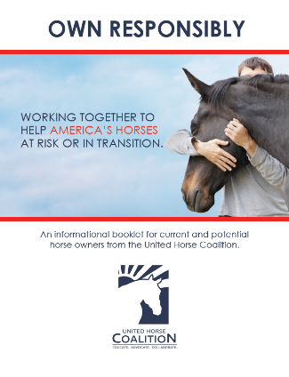
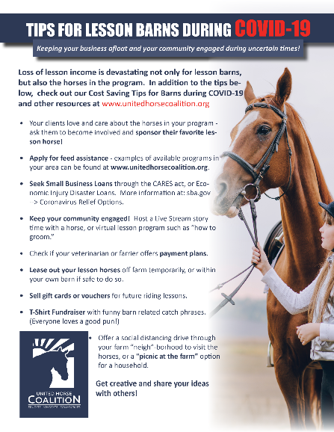
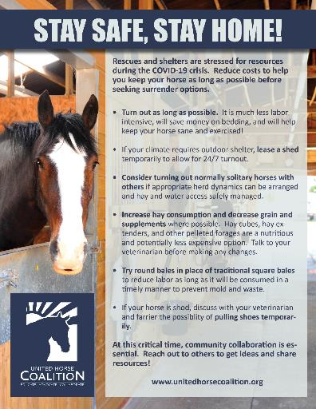
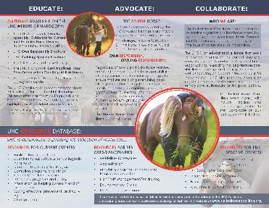
UHC Educational Materials:
Notes:
UHC creates Educational Materials promoting responsible ownership which are uploaded onto our website for our Members to utilize, as well as the general public.
Anyone is welcome to use them at events, or to pass out to your organization's clientele.

Slide 9
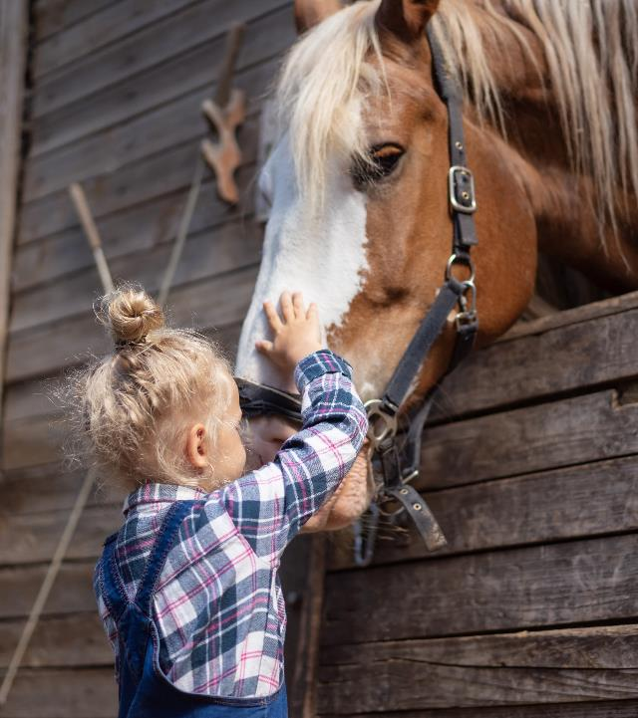
What you can do to help at-risk horses
Own Responsibly
Have contingency plans in place for your horse
Include your horse in your Estate Planning
Breed Responsibly
Join the UHC Ambassador Program
Volunteer at rescues or rehoming facilities
Donate to UHC or your local rescue – or help raise funds.
Share UHC materials on Responsible Ownership
Notes:
So to wrap things up, we’d like to go over some of the things you can do on a personal level to help at-risk horses, or even your own horse.
Own Responsibly
Have contingency plans in place for your horse
Include your horse in your Estate Planning
Breed Responsibly
Join the UHC Ambassador Program
Volunteer at rescues or rehoming facilities
Donate to UHC or your local rescue – or help raise funds.
Share UHC materials on Responsible Ownership

Slide 10
Be part of the Solution!
Let’s work at the root of the problem together – before a horse becomes at-risk.
Learn the facts and share them with other horse owners and breeders, clubs and organizations.
Help the UHC spread the word to “Own Responsibly”
Notes:
If you work in the horse industry, consider designating one person to spearhead the effort, and consult the UHC “Join the Effort” handbook for ideas.
One simple activity is to dedicate a small section of your website to the UHC, and resources for owners.
Most importantly, the UHC aims to find common ground and work together to prevent horses from becoming at-risk – consider becoming a member today!
Please spread the word to Own Responsibly.
Thank you.

Slide 11
Thank you for listening!
Feel free to contact UHC with any questions.
UHC@horsecouncil.org
www.unitedhorsecoalition.org

